Slide 1
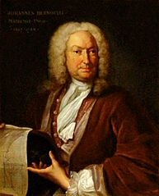
The principle’s of flight

Slide 2
(1) Lift, (2) Gravity force or Weight, (3) Thrust, and (4) Drag. Lift and Drag are considered aerodynamics forces because they exist due to the movement of the Airplane through the Air.

Slide 3
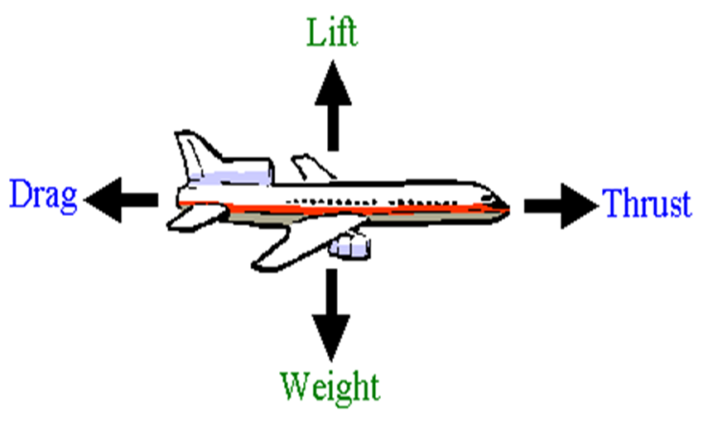
“Lift”
Four Forces Affect Things That Fly: Weight is the force of gravity. It acts in a downward direction—toward the center of the Earth. Lift is the force that acts at a right angle to the direction of motion through the air. Lift is created by differences in air pressure.

Slide 4
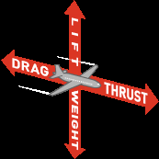
“Force/weight”
These same four forces help an airplane fly. The four forces are lift, thrust, drag, and weight. As a Frisbee flies through the air, lift holds it up. ... They push a plane up, down, forward, or slow it down. Thrust is a force that moves an aircraft in the direction of the motion.

Slide 5
“Thrust”
Thrust is the force which moves an aircraft through the air. Thrust is used to overcome the drag of an airplane, and to overcome the weight of a rocket. ... The engine does work on the gas and accelerates the gas to the rear of the engine; the thrust is generated in the opposite direction from the accelerated gas

Slide 6
“Drag”
Four Forces Affect Things That Fly: ... Thrust is the force that propels a flying machine in the direction of motion. Engines produce thrust. Drag is the force that acts opposite to the direction of motion. Drag is caused by friction and differences in air pressure.

