Slide 1
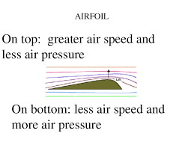
THE PRINCIPLE OF FLIGHT

Slide 2
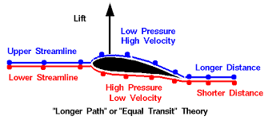
Lift: Bernoulli’s principle
Also called Bernoulli effect.
the principle in hydrodynamics that an increase in the velocity of a stream of fluid results in a decrease in pressure.

Slide 3
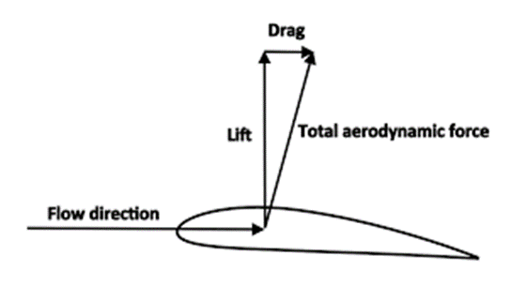
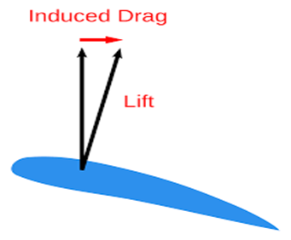
Drag
The four main forces of drag is lift, thrust, drag, and weight
Drag is a mechanical force. It is made by the interaction and contact of a solid body with a fluid (liquid or gas).
The two main factors that affect the amount of drag are shape and texture.

Slide 4
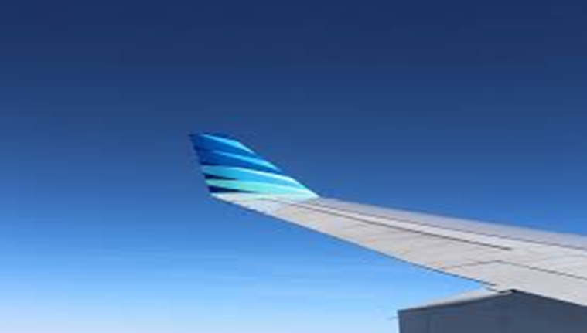
Lift: Wing Shape
This plane wing is bended so the plane can fly better. The wings shape can actually affect a lot, on that wing to the left the FAST MOVING AIR on the top has lower pressure and the SLOW MOVING AIR on the bottom has a higher pressure.
Plane wing!

Slide 5
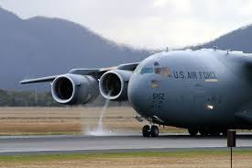
Thrust
When a system expels or moves mass in one direction, the accelerated mass will cause a force of equal magnitude but opposite direction on that system. The force put on a surface in a direction perpendicular or normal to the surface is called thrust.

Slide 6
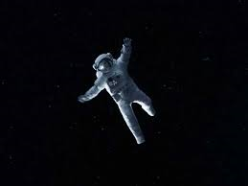
Gravity
the force that attracts a body toward the center of the earth, or toward any other physical body having mass. For most purposes Newton's laws of gravity apply, with minor changes to take the general theory of relativity into account.

