Slide 1
Principals Of Flight
Drag
Lift: Bernoulli’s Principle
Lift: Wing Shape
Thrust

Slide 2
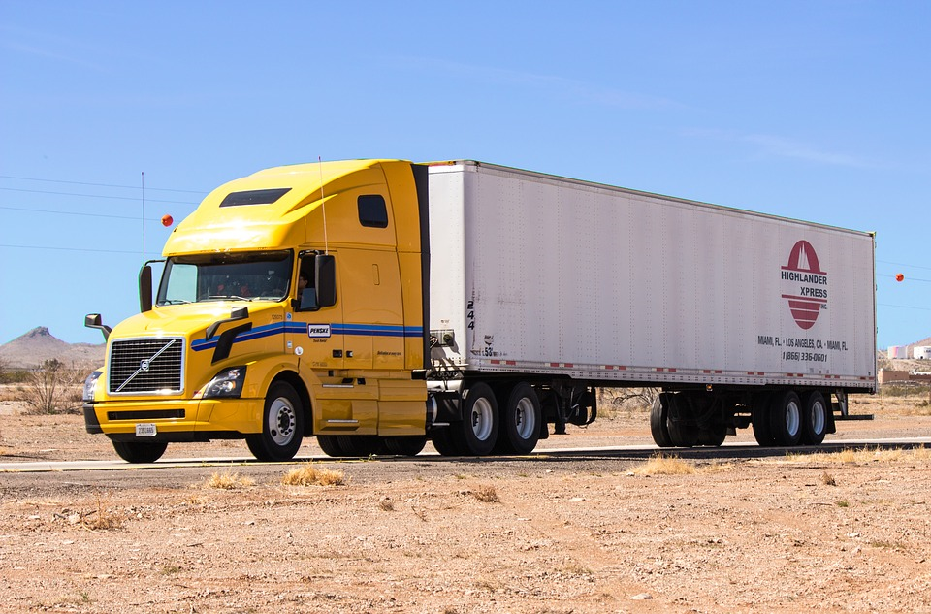
Drag
What is drag?
Drag is the force caused by air resistance. If the object is smaller then it reduces more drag, and if the object is bigger it has more drag.
The car reduces more drag because it has a rounded front for the air to go over so it goes faster.
The truck has more drag because it is bigger and catches more air which slows it down.

Slide 3
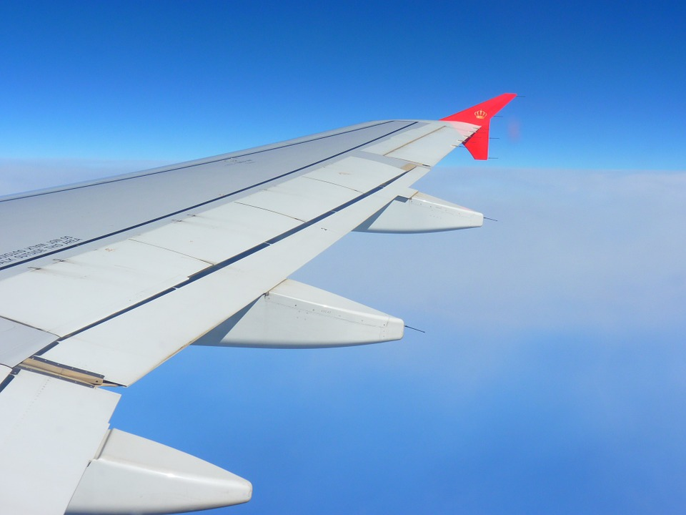
Bernoulli's Principle
What is Bernoulli’s Principle?
Bernoulli’s Principle is when the low pressure air goes on top of the object and the high pressure air goes under the object, the high pressure air goes into the low pressure air zone and pushes the object up.

Slide 4
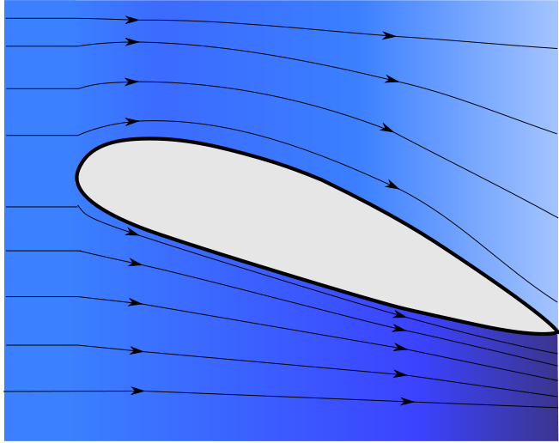
Wing Shape
What is wing shape?
Wing shape is size, reduces drag, and speed.
If the front is curved and the back is at a point it will go faster because it reduces drag.
If it is not curved in the front then it will be slower because it has more drag.
The picture shows an airfoil which is the shape of airplane wing, that shape creates lift.

Slide 5
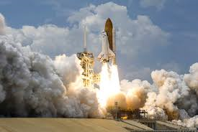
Thrust
The definition of a Thrust is the act of pushing with force. An example of thrust is a fish being removed from the ocean by a strong wave. Rocket ships use thrust when the big blast of fire goes out of the bottom and pushes it up like this picture.

