Slide 1
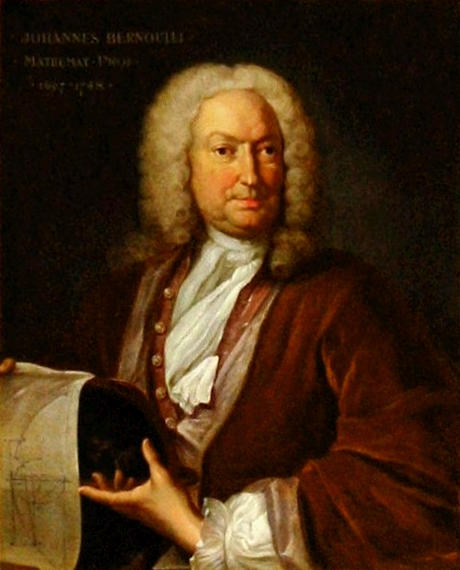
principle of flight

Slide 2
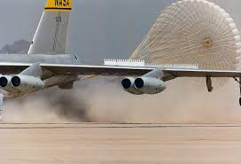
Drag
Drag is when the air it the front of a car/plane and it will make the car/plane slow down so people try to decrease drag

Slide 3
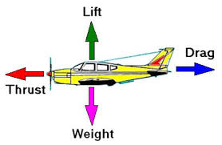
Lift
Lift is when high pressure and low pressure combined together and it with go under and over the plane wing witch will make the plane take lift .

Slide 4
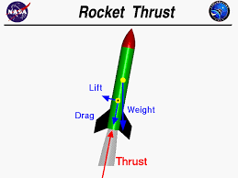
thrust
Thrust is when a powerful source pushes on a object make it move or take flight

Slide 5
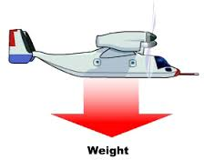
weight
Weight is a force of gravity in acts in a downward derection towards the centre of the earth.

