Slide 1
The PRINCIPLES OF FLIGHT
DRAG,LIFT:BERNOULES PRINCIPLES,LIFT WING SHAPE,THRUST BY PATRICIA MCNEIL

Slide 2
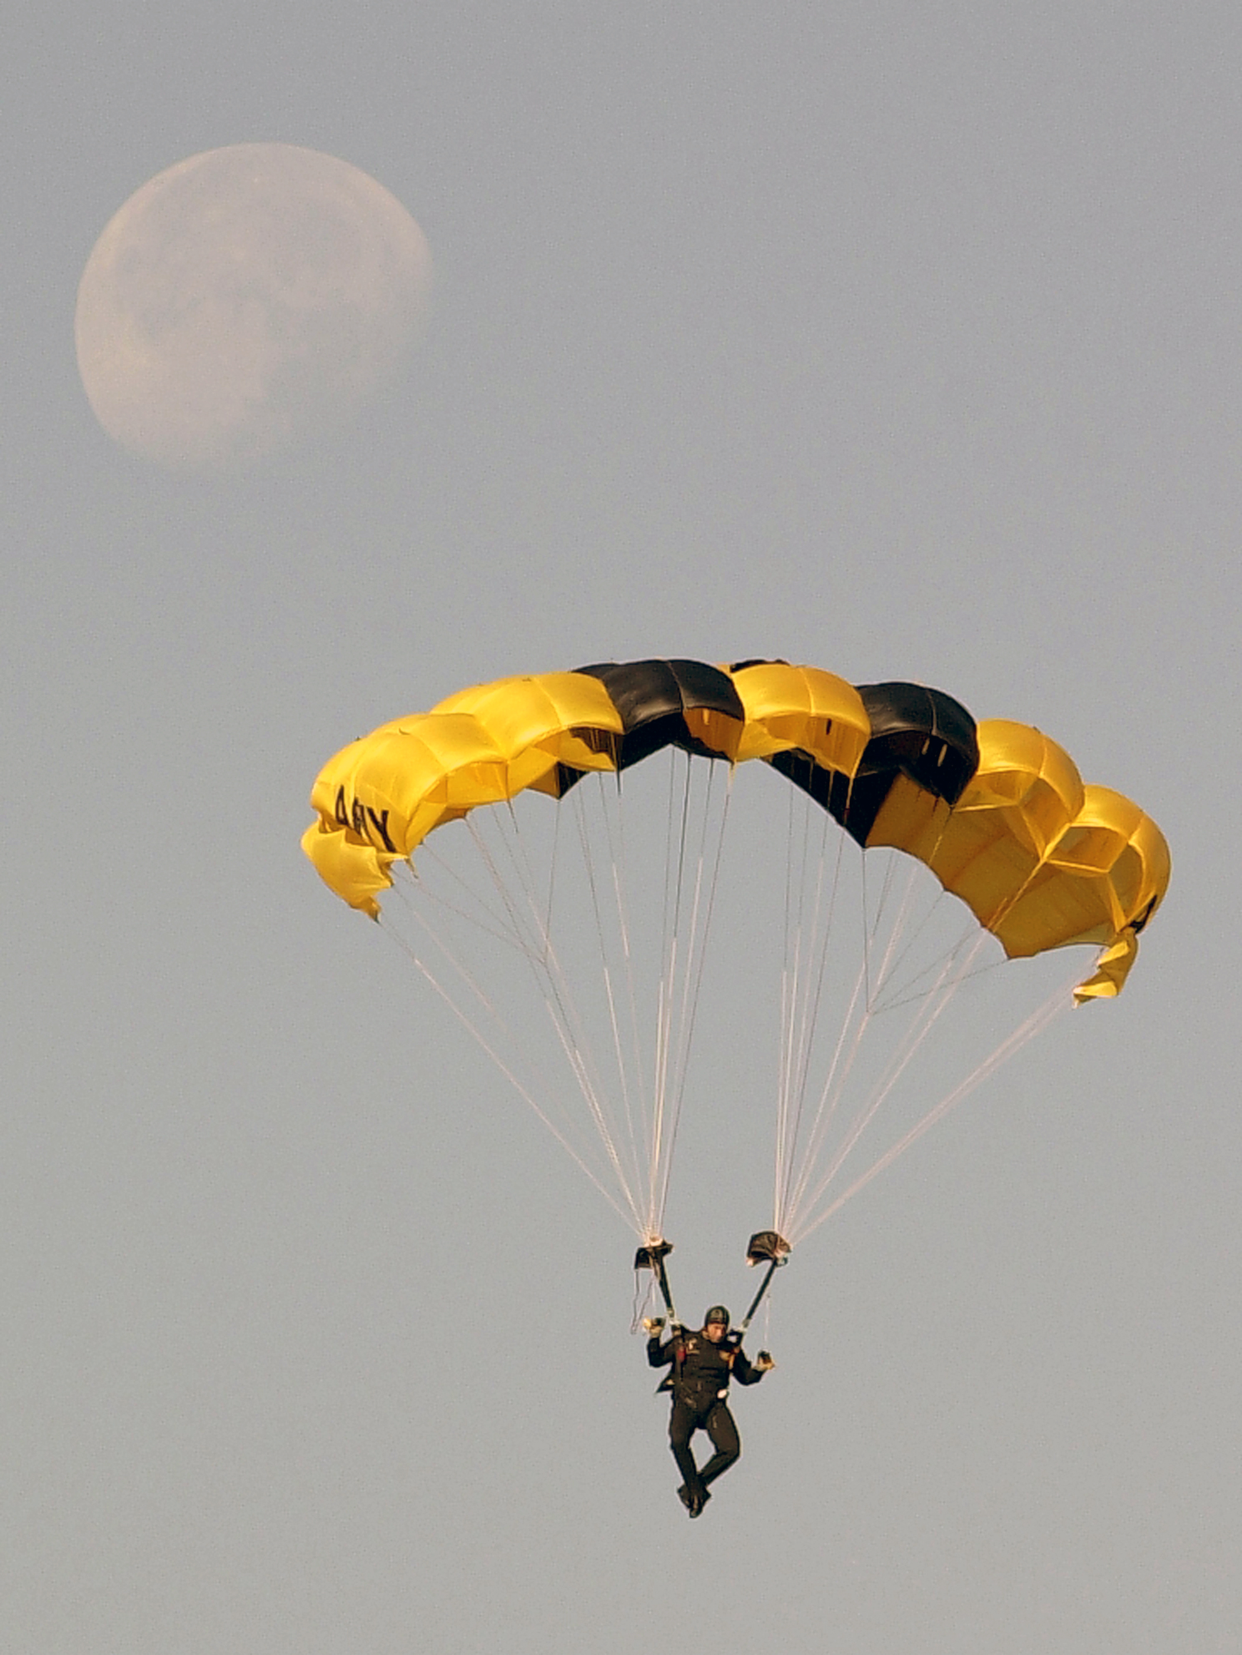
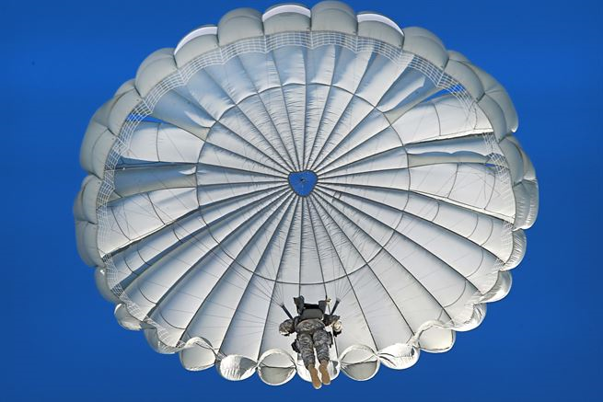
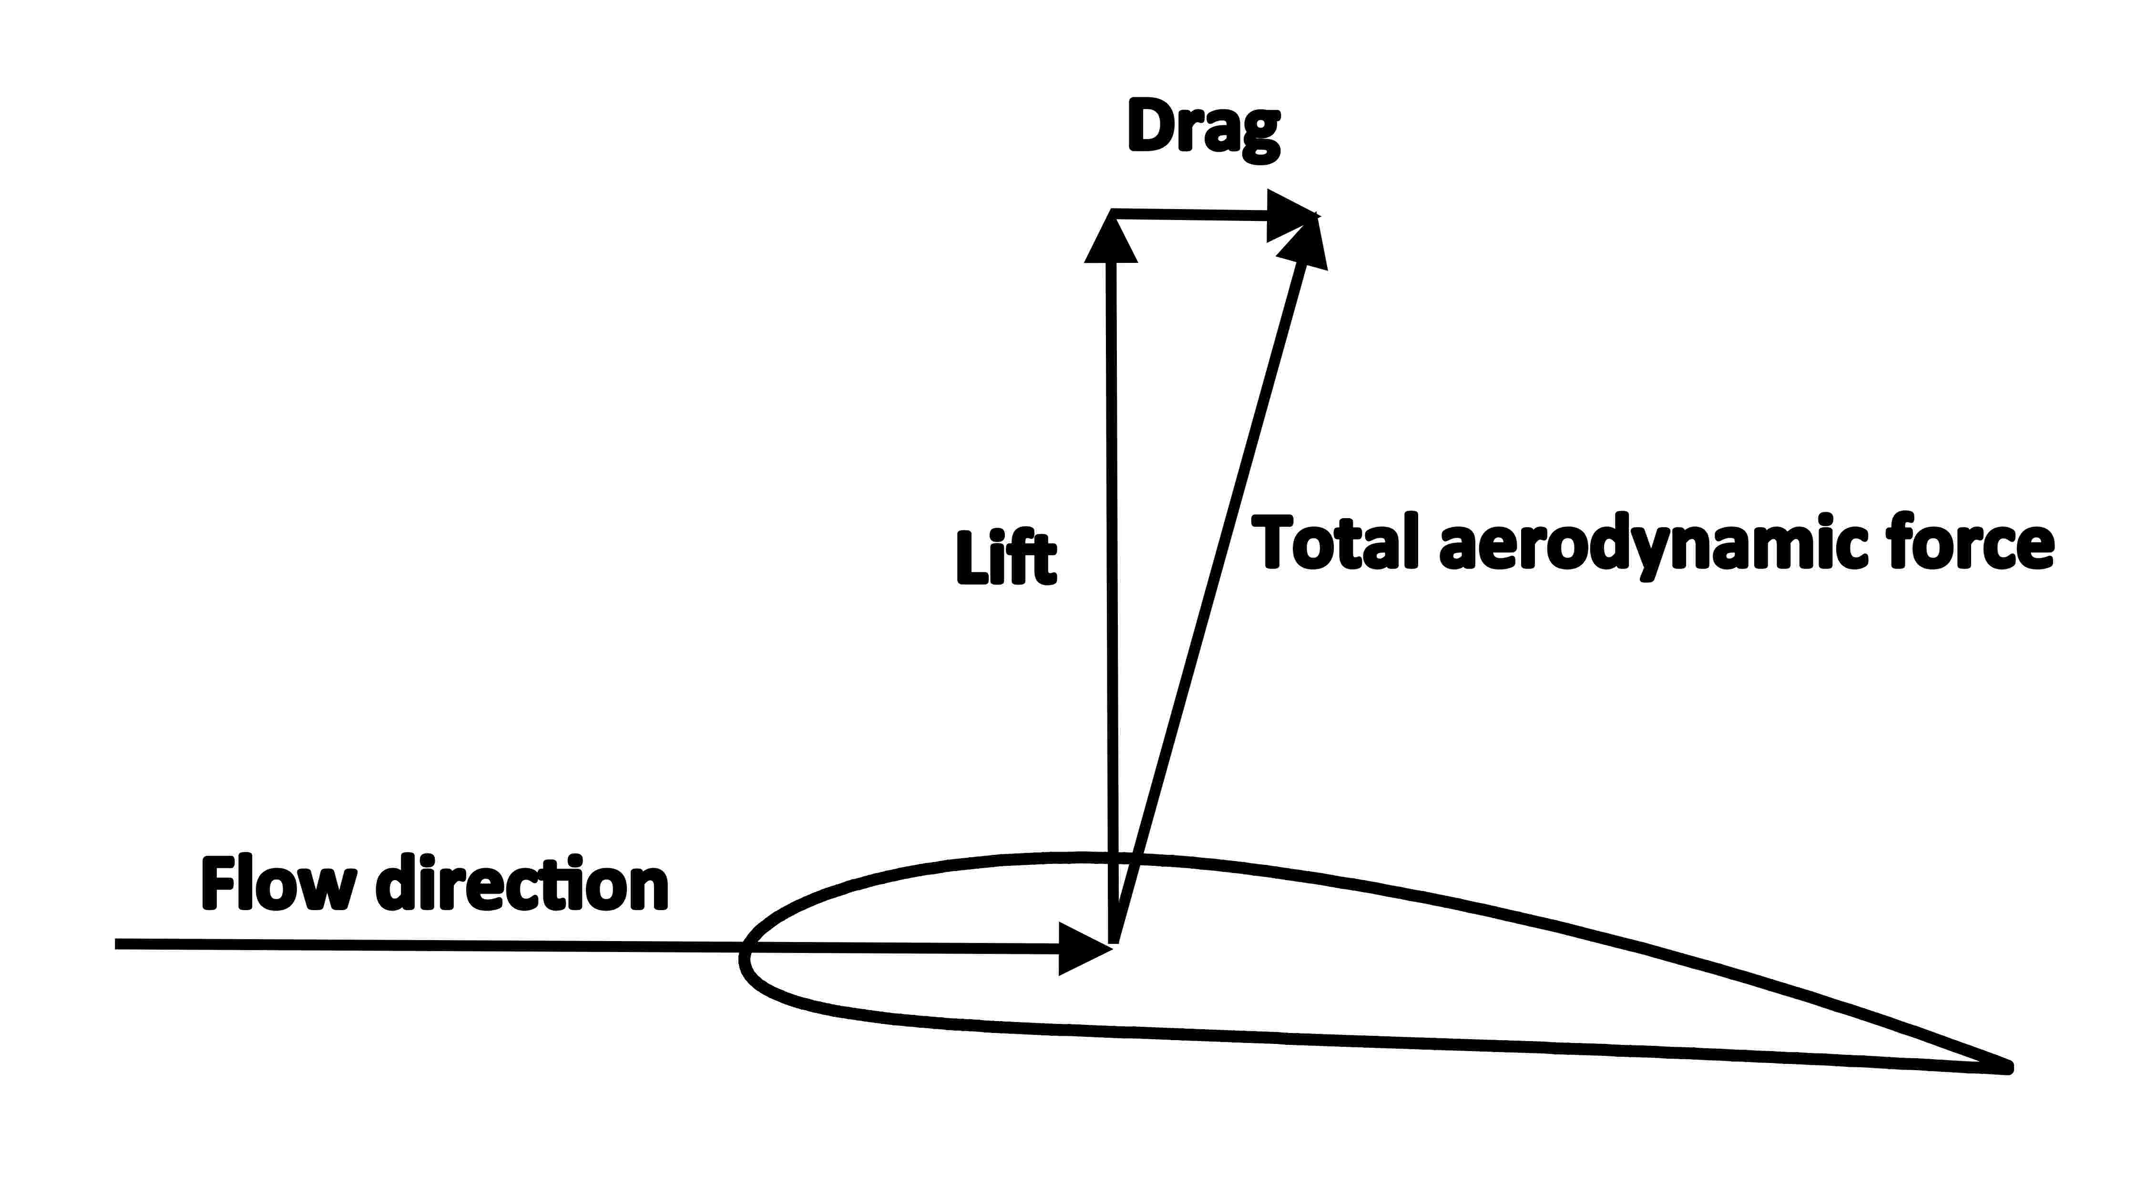
DRAG
DRAG IS THE FORCE CAUSED BY AIR RESSITANCE.

Slide 3
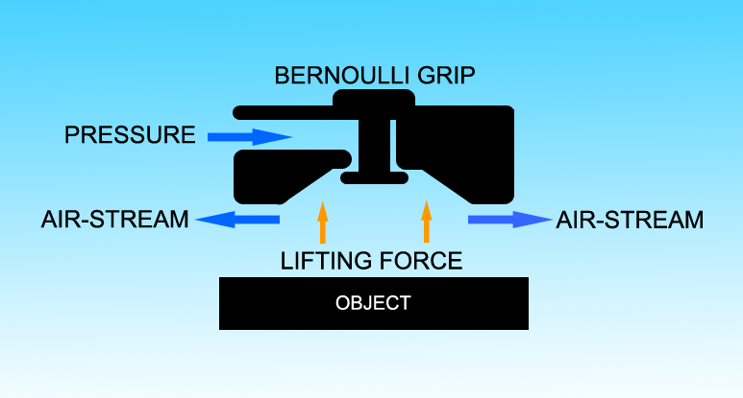
LIFT BERNOULLIS PRINCIPLE
Fast moving, hot air has LESS pressure slow moving, cold air has GREATER pressure.

Slide 4
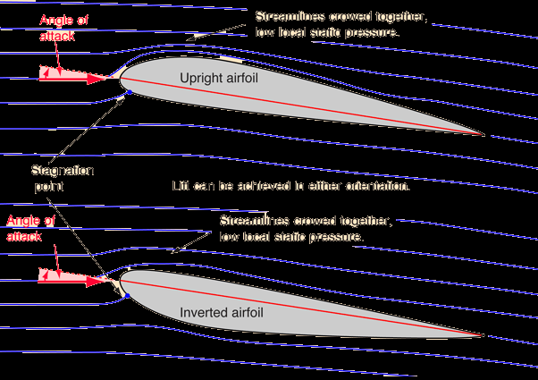
lift: wing shape
Wing shape: airfoil describes the shape of a wing that allows for lift an airfoil –a streamlined shape with a curved top –rounded leading edge(front)-a shape trailing edge(back) because of the wing shape the air moving above the wing moves more quickly.

Slide 5
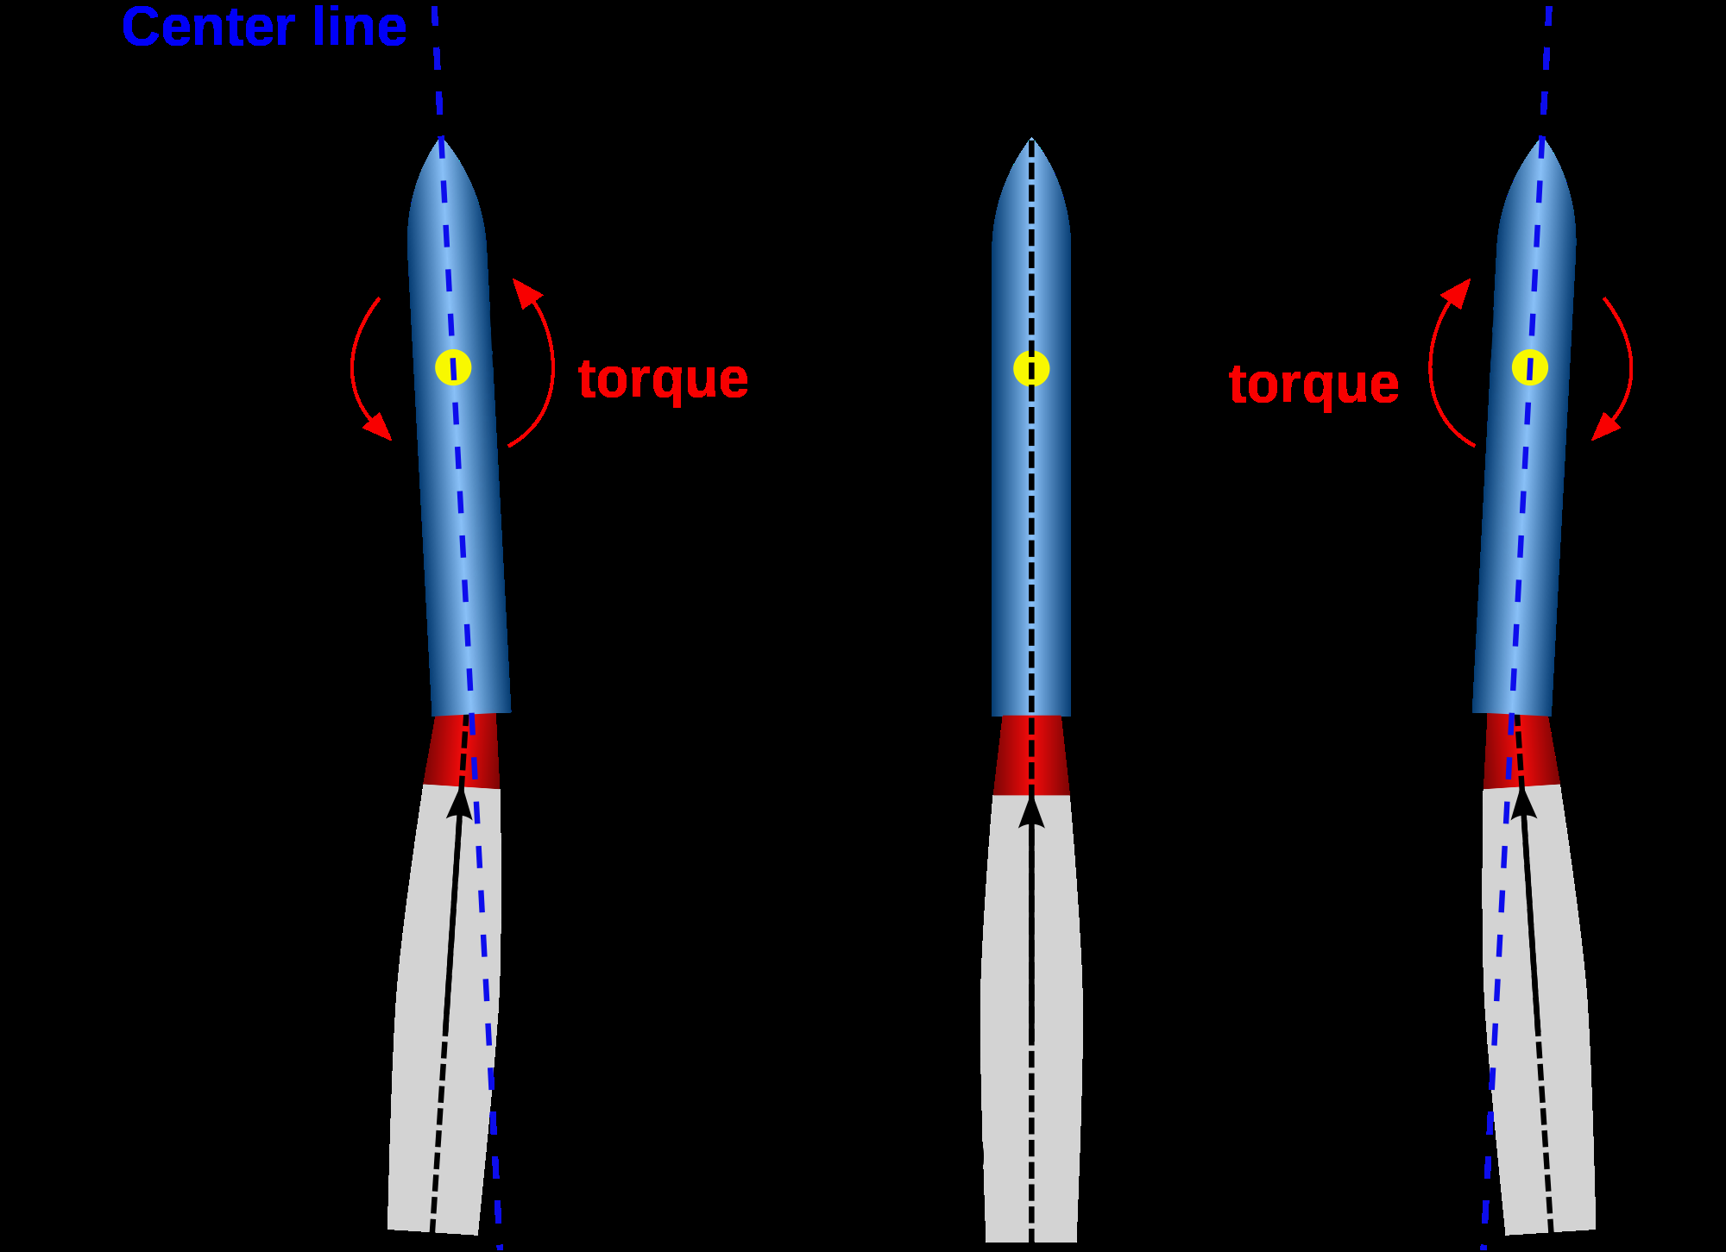
Thrust
The curved front of the blade witch resemble on air wing (air foil) forces high pressure air below the blade and the low pressure air on top when spinning fast enough lift/thrust is created.

