Slide 1
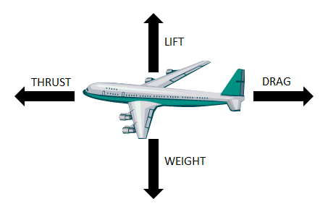
PRINCIPLE OF FLIGHT

Slide 2
DRAg

Slide 3
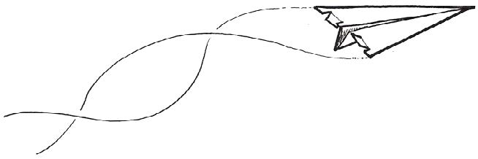
Drag is the force caused by air resistance. The two main factors that affect the amount of drag are shape and texture. Drag is the aerodynamic force that acts against an object moving though a fluid.

Slide 4
LIFT: Bernoulli’s PRINCIPLE

Slide 5
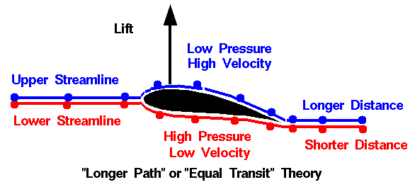
Bernoulli’s Principle- high air pressure on the bottom low air pressure on the top creates lift because the high air pushes it up.
Fast moving, hot air has less pressure.
Slow moving, cold air has greater pressure.

Slide 6
LIFT: WING SHAPE

Slide 7
Wing shape airfoil- describes the shape of a wing that allow for lift.
- a streamlined shape with a curved top
-a rounded leading edge (front)
-a sharp trailing edge (back)

Slide 8
THRUST

Slide 9
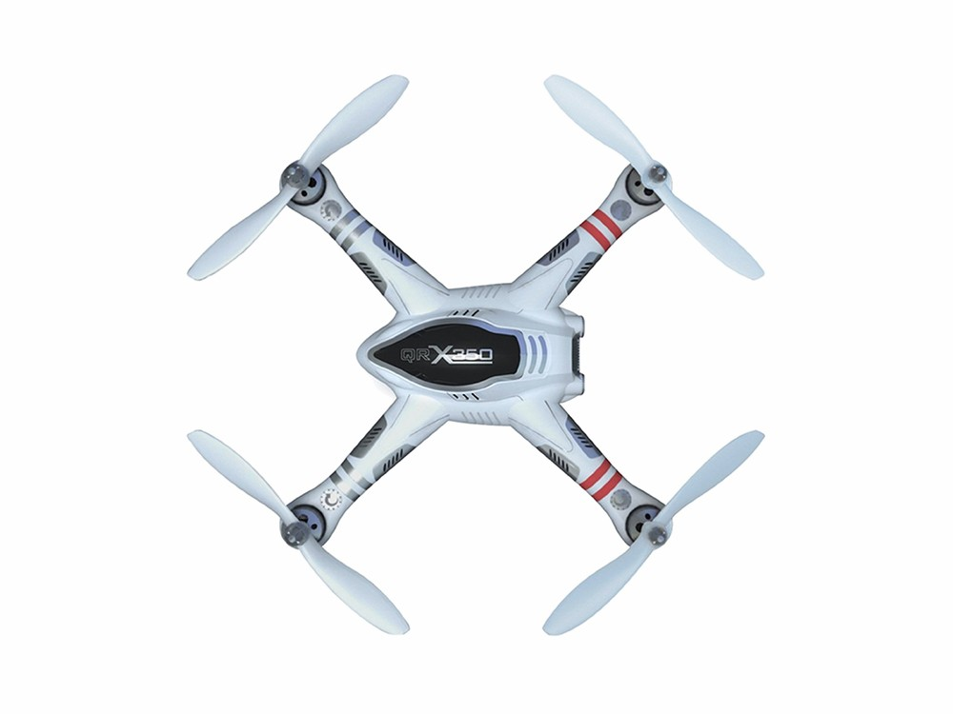
Thrust by a propeller
The curved front of the blade, which resembles an airplane wing (airfoil) force high pressure air below the blade and the low pressure air on top when spinning fast enough, lift/trust is created.

