Slide 1
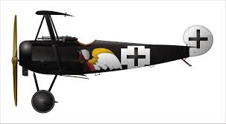
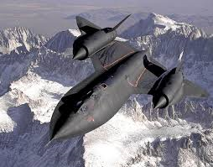
DRAG
Drag is the force that pulls back on most vehicles caused by air/water resistance.

Slide 2
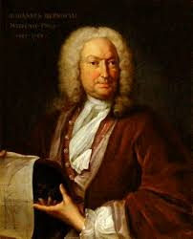
Bernoulli’s principle
This principle is that if you make a low pressure area the high pressure rushes in to fill that gap.

Slide 3
AIR FOIL
The shape of a plane wing or helicopter rotor with a curved front and sharp back.

Slide 4
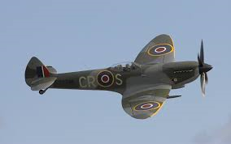
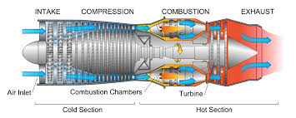
Thrust
Thrust is the force of a propeller{pulling} or jet engine{pushing} the plane to fly.

