Slide 1
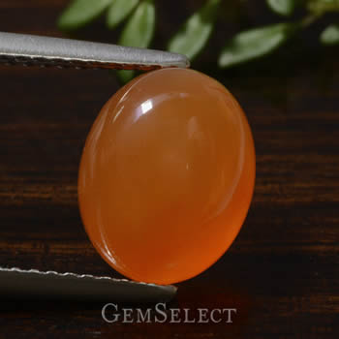
August 30 2006 carnelian
Luster it is vary shinny
Hardens it is vary hard it is vary hard to break
Couler it is red and orange
Clevage it is vary hard you could take and hammer to it an It wont break

