Slide 1
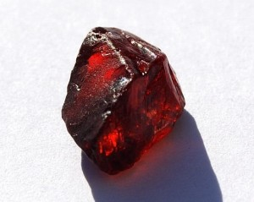
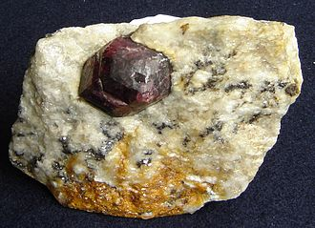
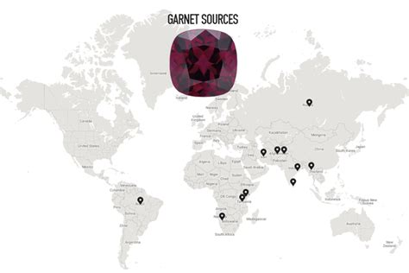
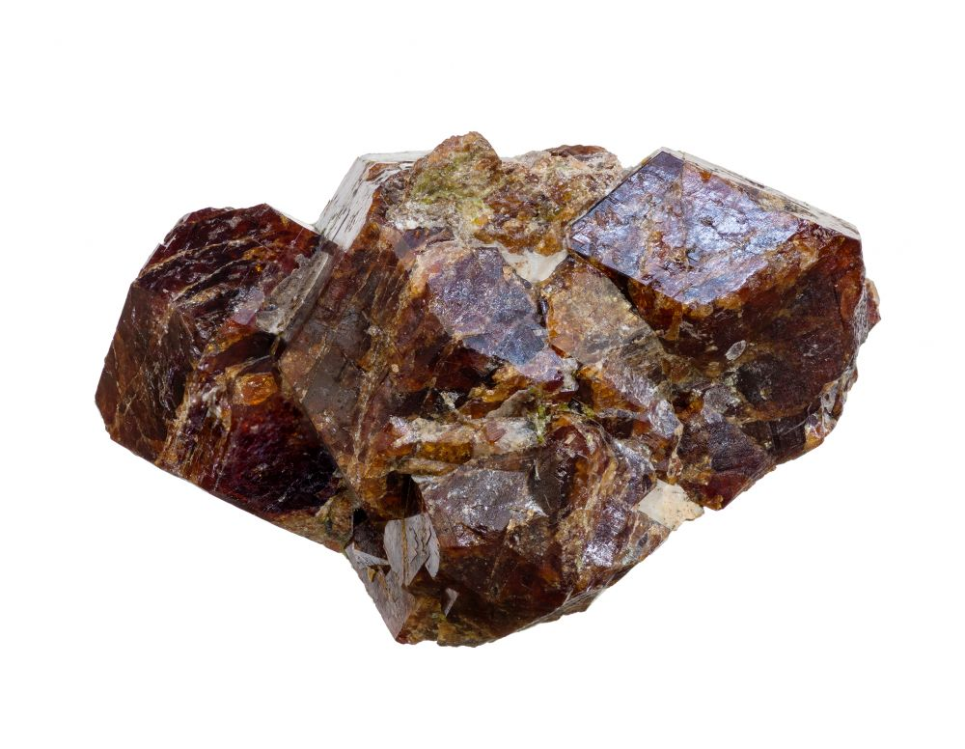
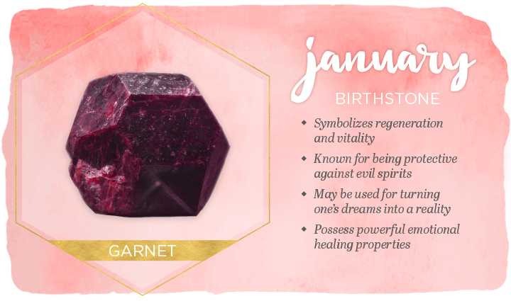
January birthstone: Garnet
The mineral's luster is known as vitreous (glass-like) or resinous (amber-like).
Garnet species are found in many colors including red, orange, yellow, green, purple, brown, blue, black, pink, and colorless, with reddish shades most common.
garnet
Cleavage when broken they shine it and shape it
hardness on the Mohs scale of about 6.5 to 7.5.
Origin Of The January Birthstone. Garnets are found in abundance in Scotland, Tanzania, Switzerland, Australia, Argentina, South Africa, Brazil, The United States and Myanmar (Burma).

