Slide 1
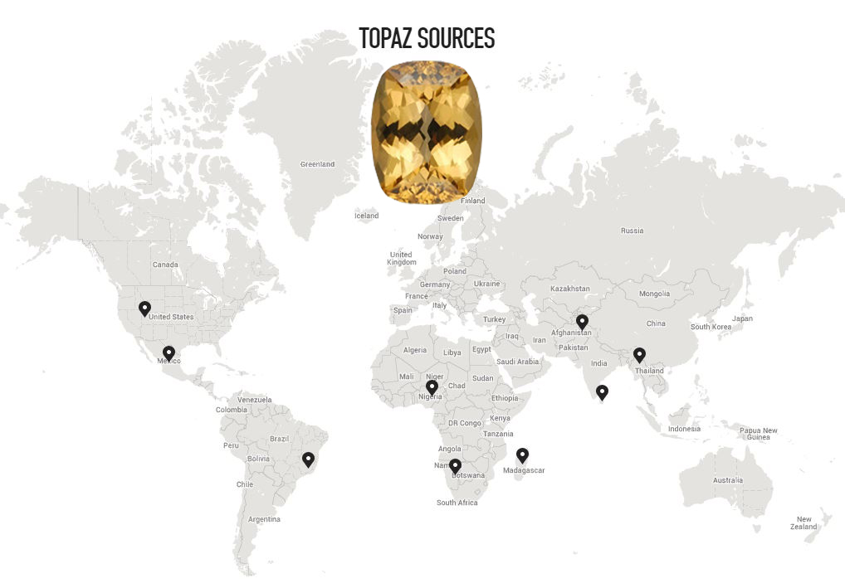
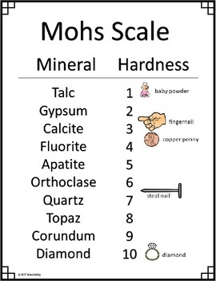
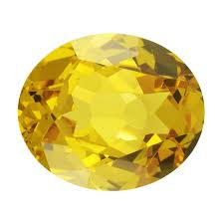
November birthstone: topaz
Topaz comes in many colors, but the 3 most common are: Yellow, pink and orange-brown.
Treated blue Topaz is worth about $20 to $40 per carat
Topaz is found in many locations
Topaz’s hardness is 8 on the Mohs scale
Topaz’s lustre is close to transparent and vitreous (glassy)
Topaz’s cleavage is 1,3 Basal
Topaz only has one use, Jewelry, though
It breaks decently easily, even though it is 8
On the Mohs scale

