Slide 1
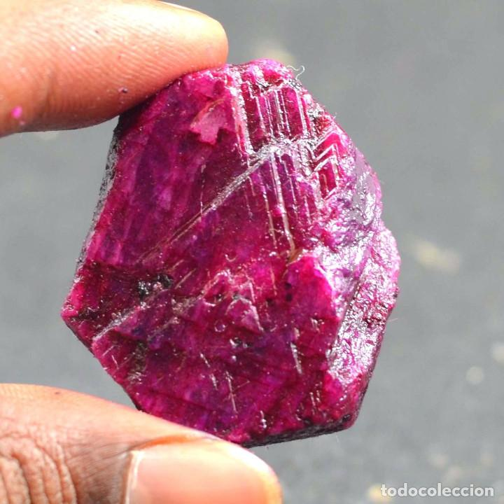
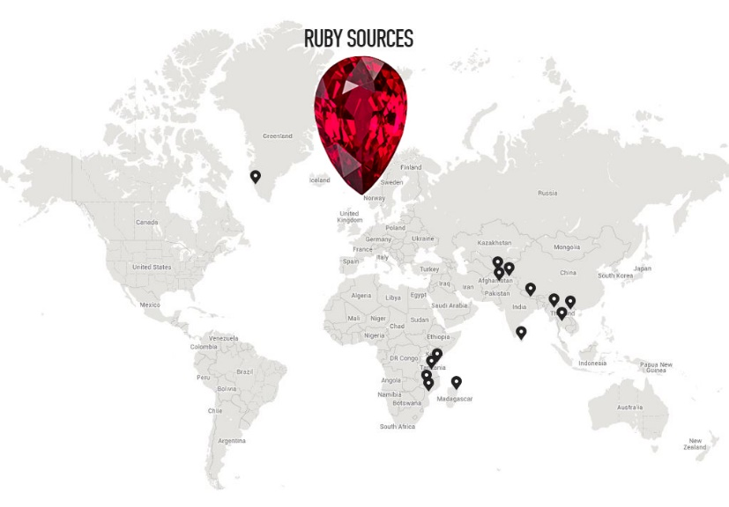
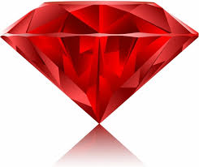
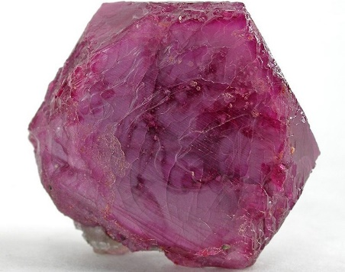
July Birthstone: Ruby
it is mined in Russia and the U.S.A
Cleavage
The ruby is the most valuable of the stones
Lustre
Rough
Shiny
Hardness
It is also used as lazers

