Slide 1
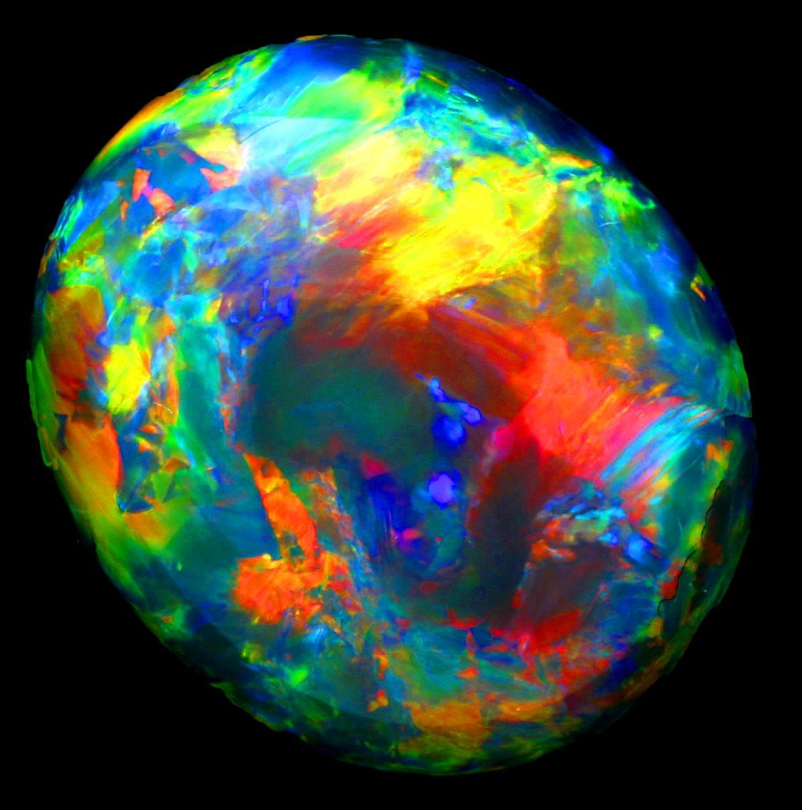
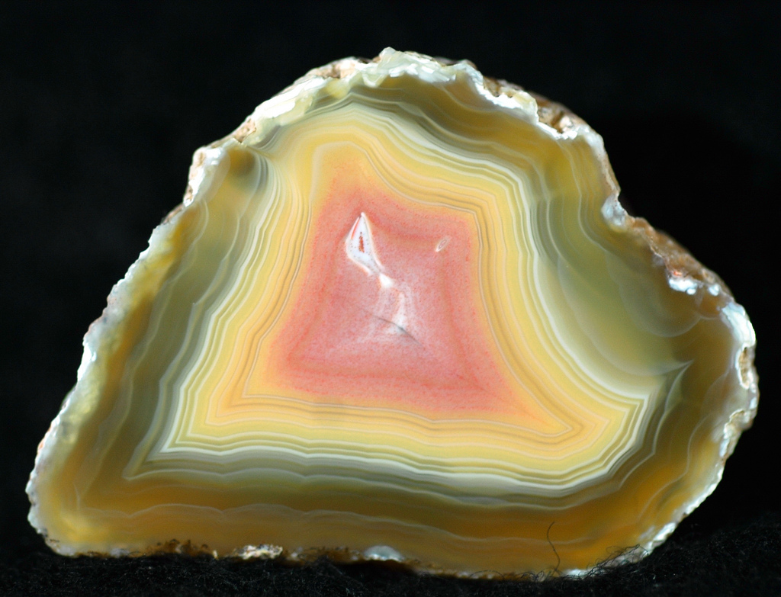
October birthstone: Opal
The hardness 5.5-6.5
Rarely shiny
The colours are yellow , orange, green, blue ,red and purple
The valuable of my birthstone is $15,000 and it is mined in Australia and mars
Cleavage is chorded

