Slide 1
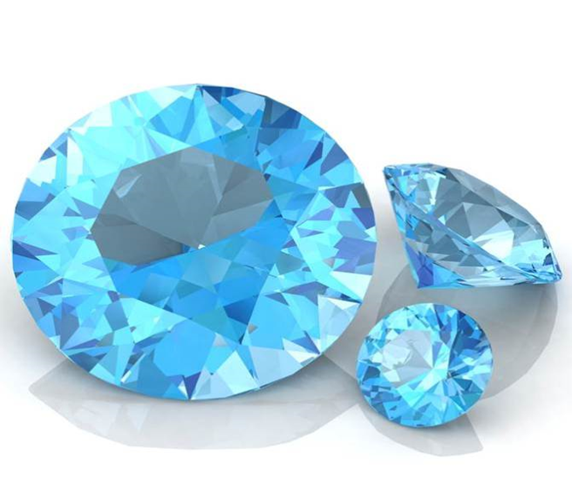
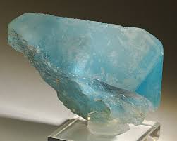
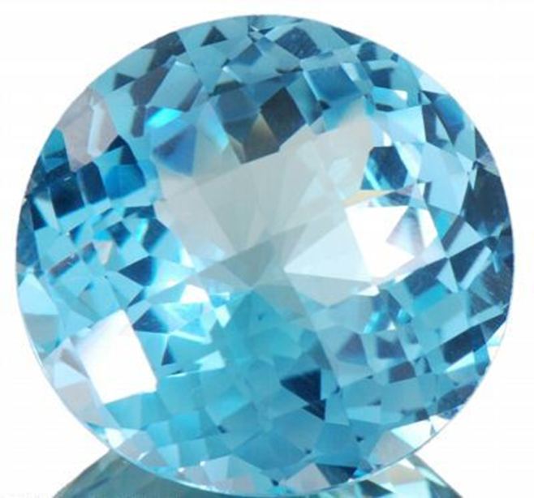
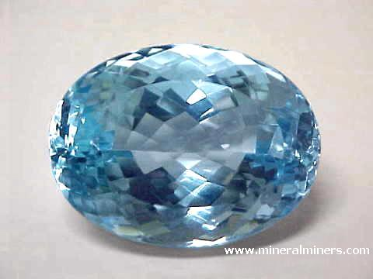
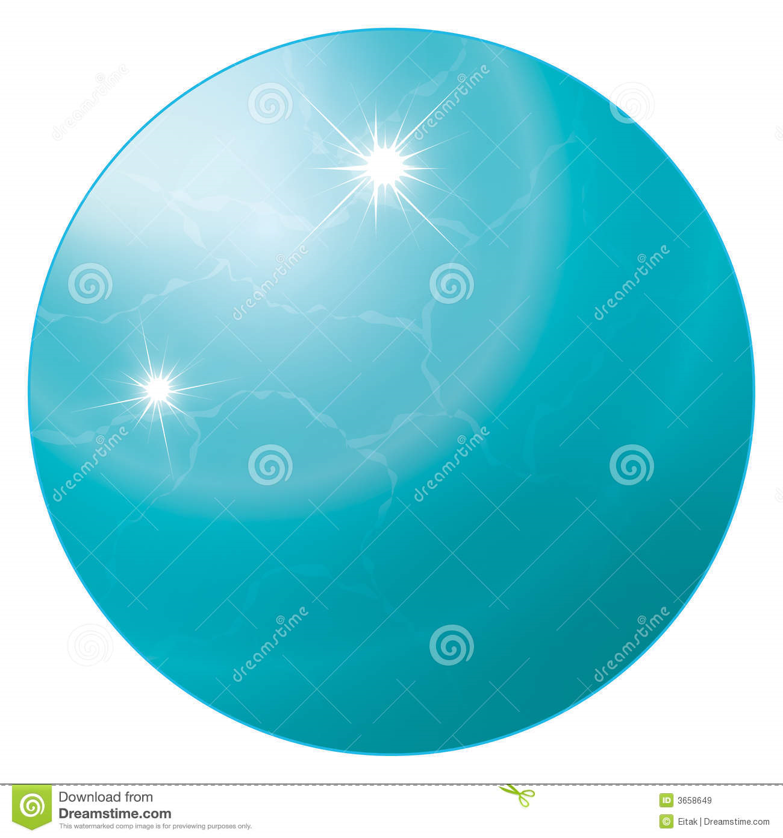
December birthstone topaz.
Its mined in Germany Norway usa Russia Mexico japan and brazil
that’s where its in more to.it is jewelry and it is hard like diamond.
Cleavage is half broken in the middle.
It is valuable it costs is 20 dollars and 40 dollars.
This topaz Lustre is really shiny.
Hardness it is half hard and it is solid.

