Slide 1
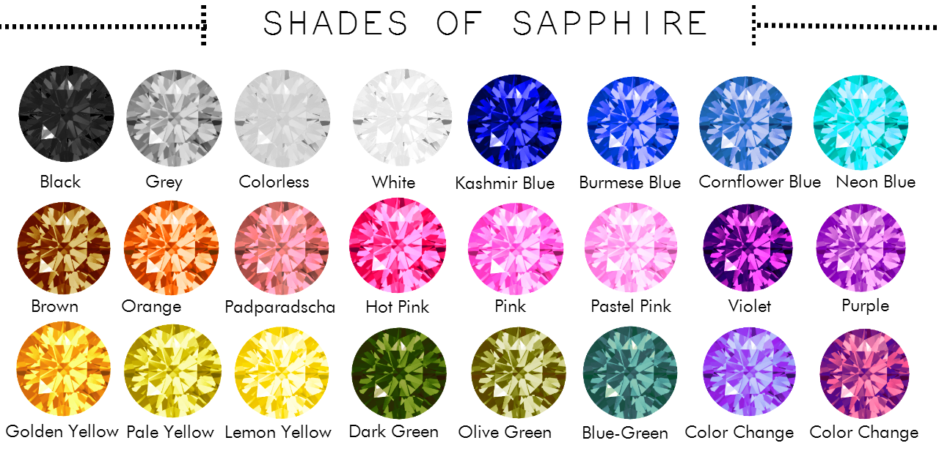
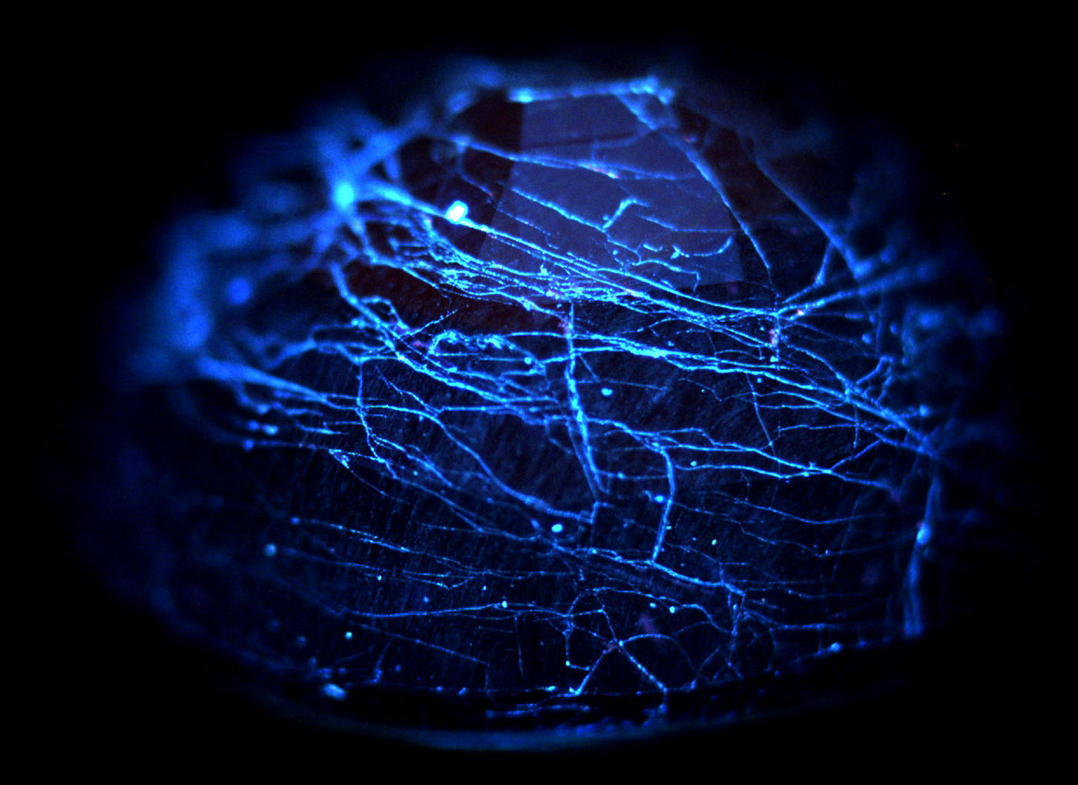
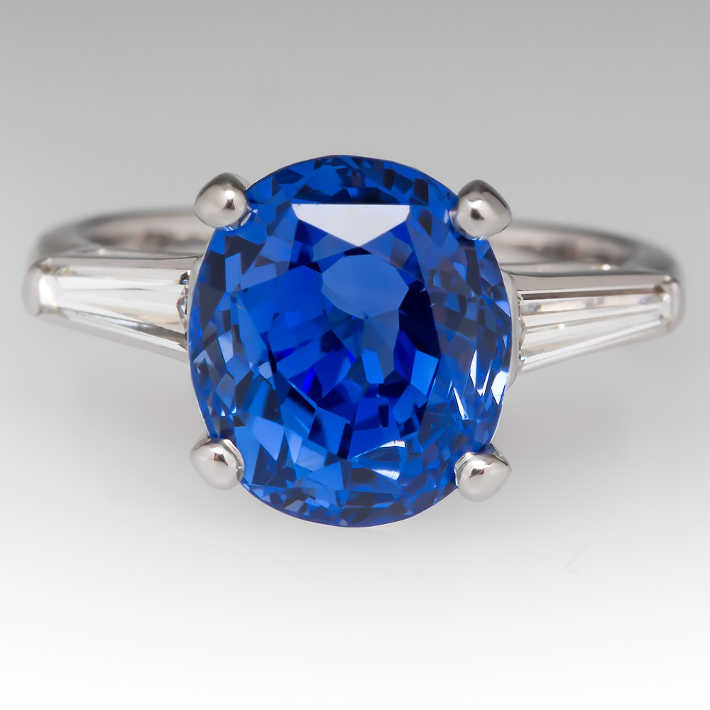
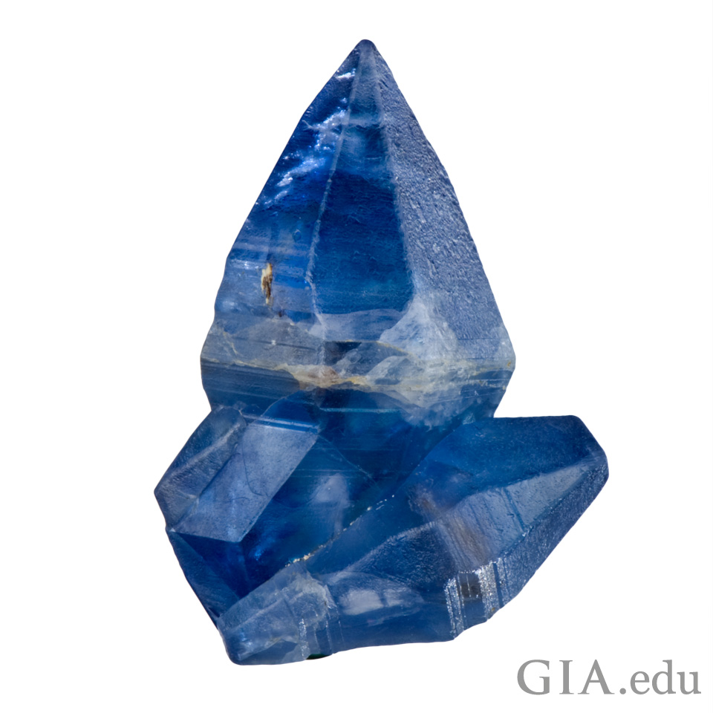
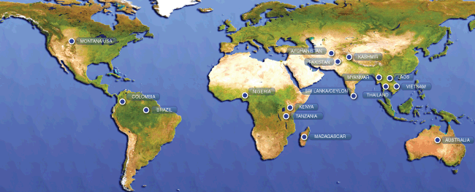
Setember birth stone:SAPHIRE
Colour: sapphires can come in multiple colours but are usually shades of blue purple green and yellow
By Maddie McIntyre
Clevage this is what a fractured sapphire looks like and I could not find a picture of a broken sapphire
And there are no other uses for sapphiers than jewlery
Sapphires are mined manly in eastern Australia,Thailand,siri lanka,china,Madagascar, east Africa,and Montana.
On a scale of one to ten a sapphire rates a 9 and a dimond would be a 10

