Slide 1
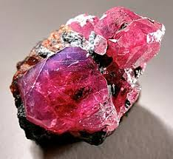
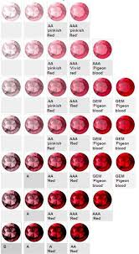
lustre lustre (shininess) vitreous of adamantine :my birthstone is minend in russia,Australia and many more place cleavage:it is crystal like :rubies are worth 100.000 per carat :colour pink,blood red :rubys are also used for rail framework hardness:Rubies have a hardness of 9.0 on the Mohs scale of mineral hardness. Among the natural gems only moissanite and diamond are harder, with diamond having a Mohs hardness of 10.0 and moissanite falling somewhere in between corundum (ruby) and diamond in hardness.

