Slide 1
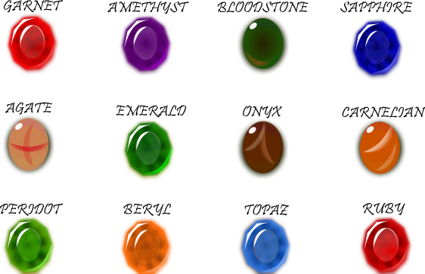
My birthstone is amethust its purple
It a little glassy
It is hard the shape is circle.
Its only worth a
couple of dollars
U can find it at the pond shops and they us it for jewley.it is mined in Siberia.

