Slide 1
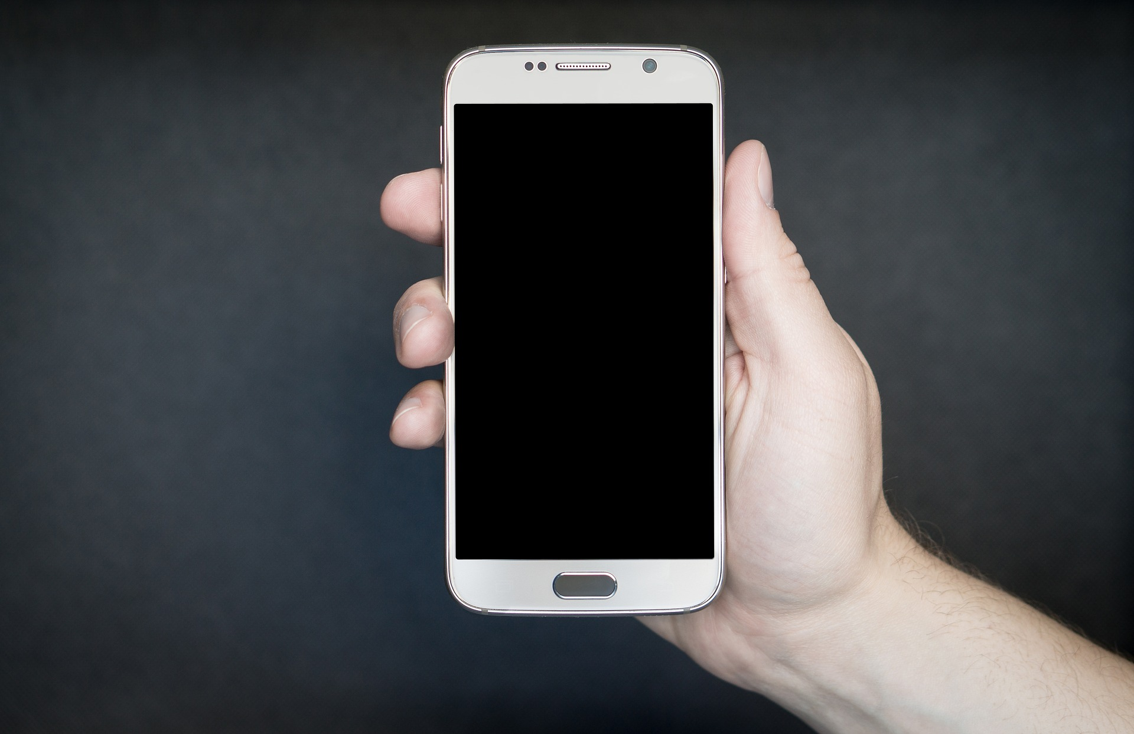
BRING YOUR OWN
DEVICE (BYOD)
Procedures, Policies and Expectations

Slide 2
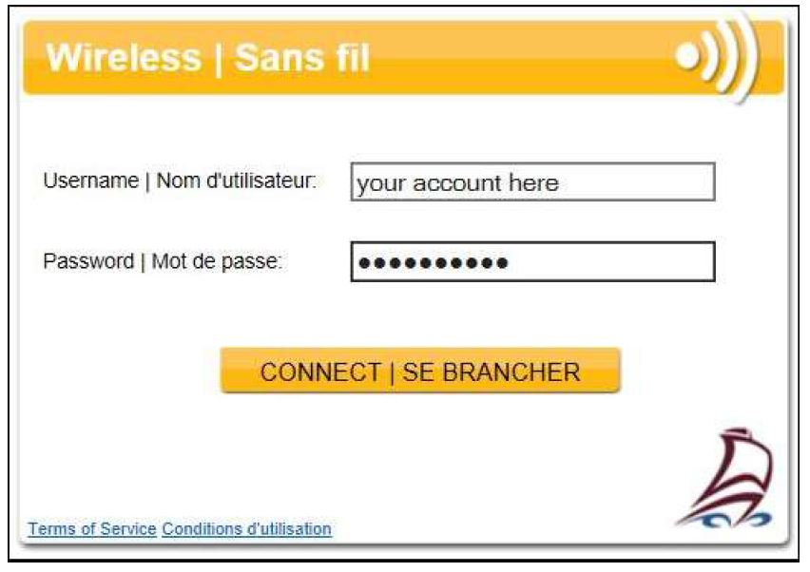
LOGIN PROCEDURE...
Go to your WIFI Connections under Settings
Choose NB-Internet...Password is Education! (only need to do this once)
Your login account is the account you use to login to a computer on the NBSS network but does not require the NBSS\ prefix.
Note: You will need to enter these credentials on each visit to the school or when you move outside wireless coverage. You can get this window by opening a browser to a website like yahoo.ca
Notes:
Ashley will discuss this slide

Slide 3
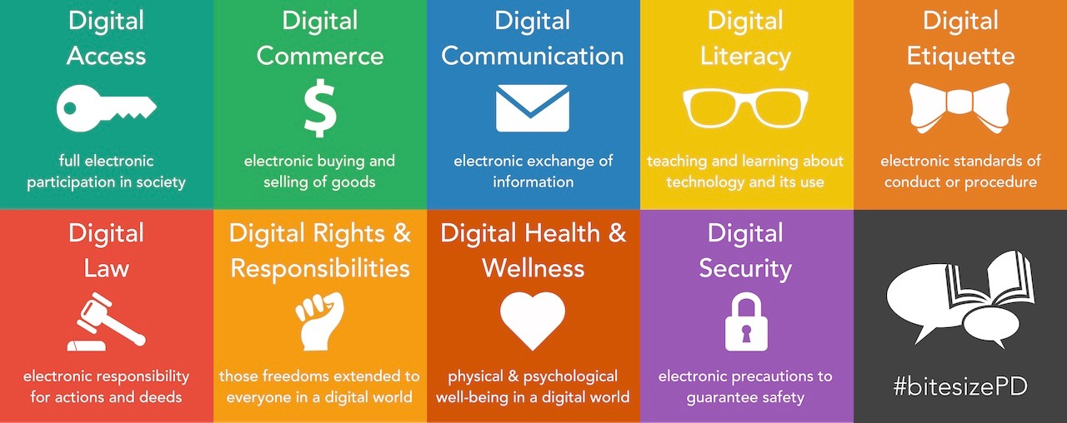
DIGITAL CITIZENSHIP...
BE
Safe
Understanding
Polite
E-Healthy
Responsible
Image from: https://www.fractuslearning.com/wp-content/uploads/2014/09/digital_citizenship_1280.png
Notes:
Allan will discuss this slide

Slide 4
DLMS Tech AGREEMENT...
The use of personal electronic devices during the instructional day is to support student learning and educational activities; personal use is limited to before school, breaks, noon hour and after school.
The student is responsible for keeping his or her device in their possession or properly securing it, at all times. School or District personnel are not responsible for the security or condition of student’s personal devices.
The student is responsible for the proper care of personal technology devices, including all maintenance and repair, replacement or modifications, and software updates necessary to effectively use the device. They are also responsible for ensuring that their device is compatible with the school Wi-Fi.
All users are required to utilize the school’s secured wireless network to access the Internet during instructional time
Notes:
Allan will discuss this slide

Slide 5
DLMS Tech AGREEMENT...
The student may only use personal technology devices in class with consent and under the direct supervision of a faculty member.
Personal electronic devices must not disrupt the learning of others.
The student must comply with the teachers’ request to verify connection to the wireless network, refrain from using a device, or to power down (turn off) the device.
The student may not use any devices to record, transmit or post photos or video of a person without their knowledge and consent. Images, video, and audio files recorded at school may not be transmitted or posted at any time, without the expressed permission of a teacher or administrator.
Notes:
Allan will discuss this slide

Slide 6
DLMS Tech AGREEMENT...
Violations may result in the loss of privilege to use personal technology in school, and/or disciplinary and legal action, as appropriate.
The School reserves the right to confiscate and/or inspect personal technology devices if there is reason to believe that it was used to violate our policies, administrative procedures, school rules, or for general misconduct.
Notes:
Allan will discuss this slide

Slide 7
BYOD VIOLATIONS...
Any violation of the agreement will result in the removal of the student’s BYOD privileges for a set period depending on the infraction (to be decided by principal and/or teacher).
According to Policy 311...students are not to share usernames/password credentials with anyone. With that said, WIFI logins are easily monitored. If there are multiple logins under one student account, this account will lose their BYOD privileges. Remember...sharing means that person is now representing your actions while on this network!
Notes:
Ashley will discuss this slide

Slide 8
BYOD NEXT STEPS...
1. All students are expected to sign the DLMS Technology Agreement at the beginning of the school year. This agreement covers both school devices and personal device use.
2. All students are asked to register their devices –
https://forms.office.com/Pages/ResponsePage.aspx?id=318rTdLEEUmHCWjML0Zcn52xLsnC5RxGoISBYV2chuRUNENYR1g0VldVWlNHVUxRTFFWODZDSUc0My4u
Notes:
Ashley will discuss this slide

Slide 9
OFFICE 365
→ You can get a MS Office 365 as a student for free
→ All RTI classes will focus on using Office 364
Image from: https://www.office365product.com/product/microsoft-office-365-proplus-lifetime-subscription-5-devices-pcmac-2016/
Notes:
Ashley will discuss this slide

Slide 10
STUDENT EMAIL… OUTLOOK
→ Access email from school… username@nbss.nbed.nb.ca
→ Shortcut on School Homepage
→ Get OFFICE 365 from your account…
Click on your initials (top right)
Click on My Account
Click on Install Office
http://blackville.nbed.nb.ca/
Notes:
Ashley will discuss this slide

Slide 11
Image from: https://www.ringdna.com/blog/byod-programs-create-mobile-app-adoption
Notes:
***Pass out the BYOD Agreement to take home

