Slide 1
Grade 8 Social Studies Unit: Atlantic Canada - Physical Setting

Slide 2
Purpose of this Unit
The Atlantic Canada unit is one that we were to supposed to cover after March Break and one that is important as you move into Grade 9 Social Studies, which focuses on Canada’s history and geography. Therefore, I am including this unit as a learning opportunity for my students in 8R.
It will begin with a focus on mapping – mapping Atlantic Canada and understanding different types of maps. Next, we will critically question maps. And we will end the unit with a focus on weather patterns and climate change in Atlantic Canada.
I will add new information each week, but feel free to work at your own pace.

Slide 3
This slideshow is meant to cover two weeks of work (April 20th – May 4th) Your tasks:
1. Atlantic Canada map activity – identifying key elements and colouring
2. Graphic organizer on different types of maps
If you finish early and would like to move on to the next section, email me at krista.cabel@nbed.nb.ca and I will send it to you.

Slide 4
Activity: Reviewing Atlantic Canada Geography
If you have access to a printer, complete the mapping activity on my Teacher Page entitled “Mapping Atlantic Canada” I will also included it on the next two slides.
If you need help with this activity, check out the Natural Resources Department of the Government of Canada:
http://ftp.geogratis.gc.ca/pub/nrcan_rncan/raster/atlas_6_ed/reference/bilingual/maritime.pdf

Slide 5
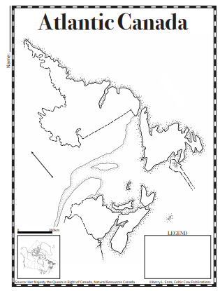

Slide 6
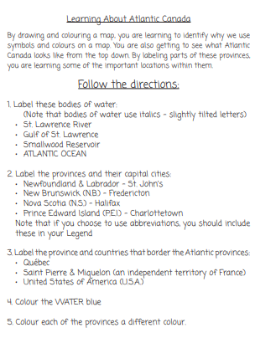

Slide 7
Quick Write
Choose one place from the Atlantic Canada map that you’ve visited. Write or draw about your experience visiting that area. You may complete your quick write on this slide or in your writers notebook.

Slide 8
Thinking Question: How do we use mapping in the real world?
video games, GPS in your car, Snapmap, Pokemon Go, Google Maps, etc.

Slide 9
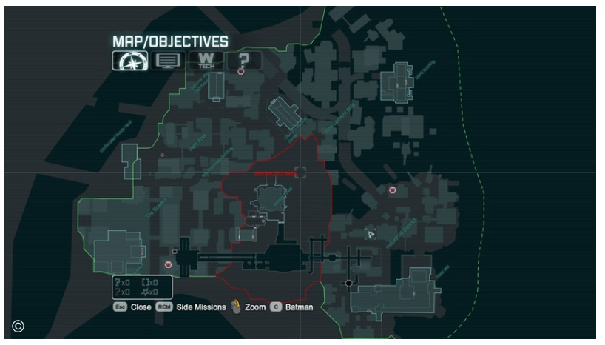
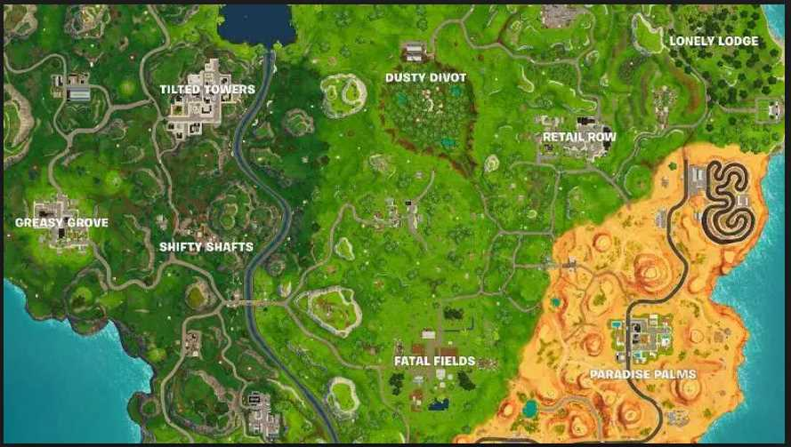
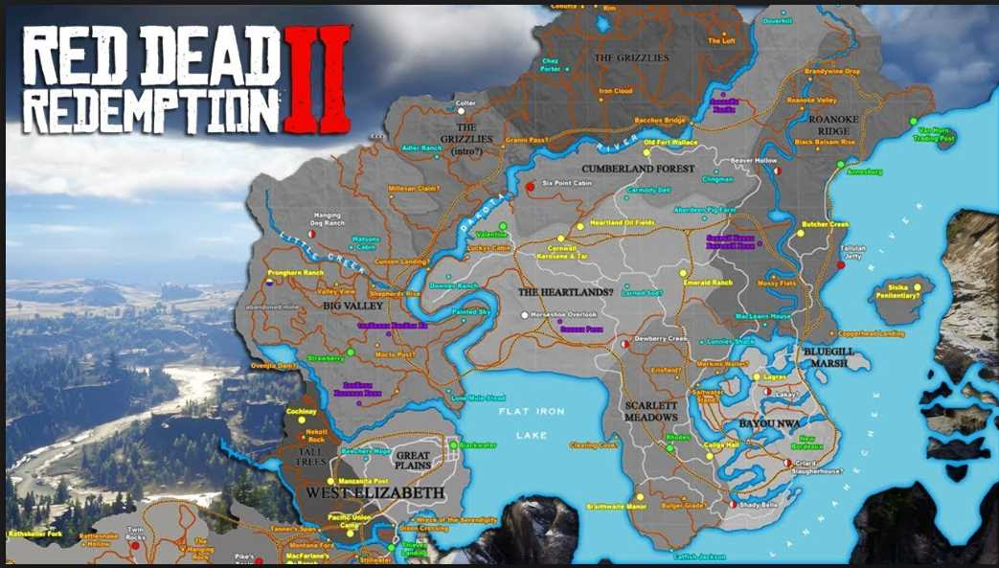
Ways we use maps every day...
video games

Slide 10
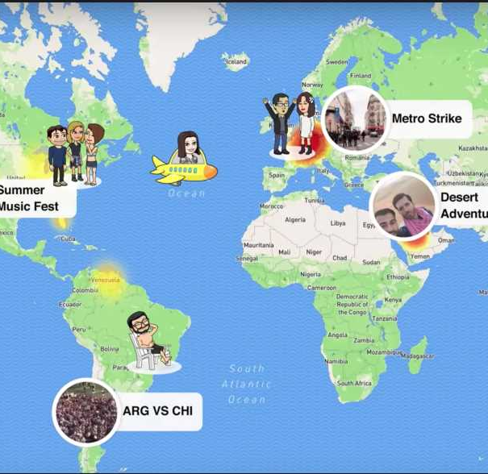
Snapmap

Slide 11
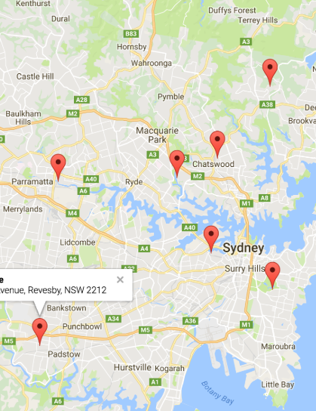
Google Maps

Slide 12
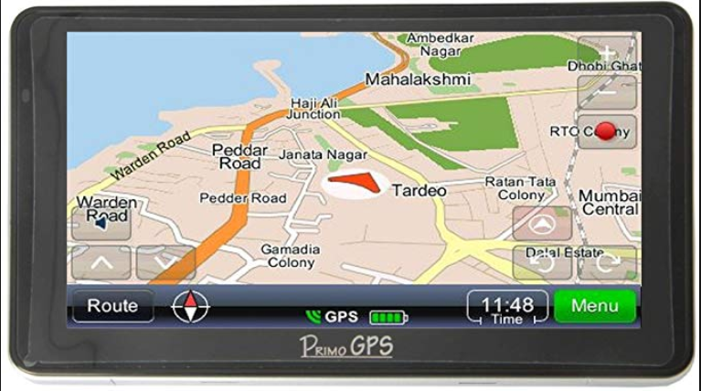
GPS

Slide 13
Even from the last few slides, you can tell that there are many different types of maps that exist. We will be learning about the following:
1.Street maps
2. Topographic maps
3. Political maps

Slide 14
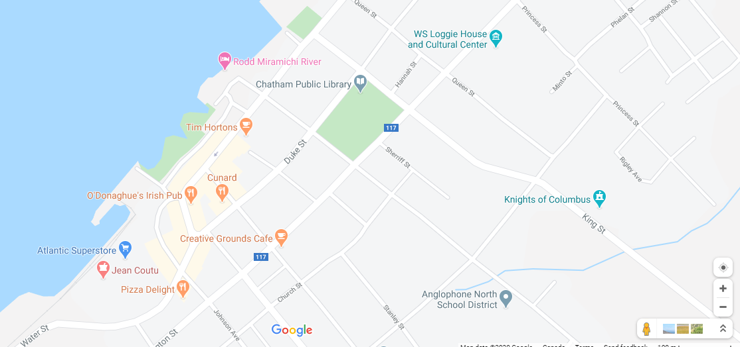
Street

Slide 15
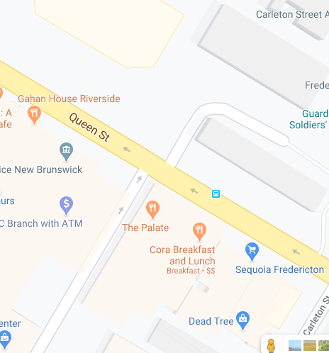
What are street maps?
Street maps usually cover an area of a few miles or kilometers (at most) within a single city or extended metropolitan area.
Today, Google Maps is the world's most popular online mapping system. In addition to maps, the service also provides travel route directions. It can create directions for people who are driving, taking public transportation, walking, cycling or taking a plane.

Slide 16
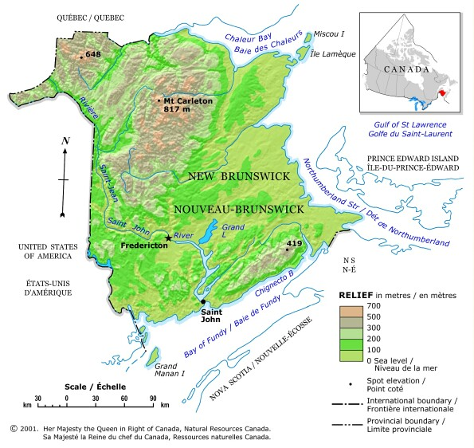
Topographic

Slide 17
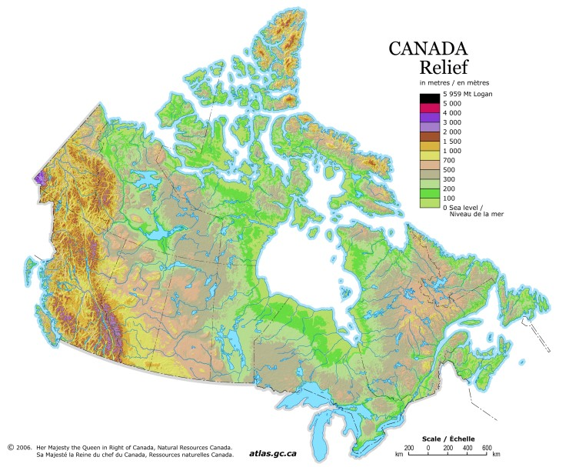
What are topographic maps?
Topographic maps are reference maps that show the shape of Earth’s surface. They usually do this with lines of equal elevation known as “contour lines”, but elevation can also be shown using colors (second map), color gradients, shaded relief and a number of other methods.
Topographic maps also show other important natural features such as lakes, rivers and streams. Their locations are determined by topography, making them important natural elements of topographic maps.

Slide 18
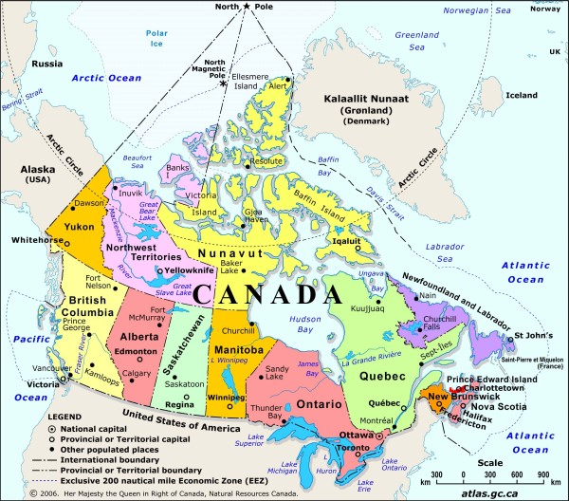
Political

Slide 19
What are political maps?
A political map is different than other types of maps because it focuses on government or administrative boundaries rather than geographical or physical features. Instead of showing viewers what exists in the land, it shows those imaginary lines that serve to separate countries, states, territories, and cities. These maps generally include larger bodies of water, such as oceans, rivers, and lakes, as landmarks. In fact, in many places, a coastline or river will serve as a political border. In contrast the many different types of physical maps emphasize the topographical, climate, geological or other features of an area. In these maps, political borders or even the existence of towns and cities are only used as reference points.

Slide 20
Your Task
Complete the graphic organizer in the packet on my Teacher Page called “Types of Maps”. Use the graphic organizer provided to investigate the key attributes of each type of map, the purpose of each style of map, where you would see this type of map, when you would use it, and the advantages and disadvantages of each type.
I will also include the graphic organizer on the next slide if you prefer to type it on the slide itself.

Slide 21
Type of Map | Key attributes of this type of map (key things you notice that are on it) | Purpose of this type of map (what can it be used for) | Advantages of this type of map | Disadvantages of this type of map
Street
Topographic
Political

Slide 22
Exit Activity
Look at this contour map of New Brunswick. What do you notice about the geography of New Brunswick from this map? Type your answer below:

Slide 23
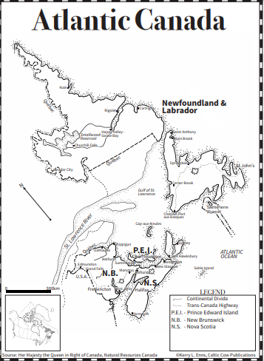
Answer Key for Atlantic Canada Map

Slide 24
Map Sources
Natural Resources Canada (https://www.nrcan.gc.ca/maps-tools-publications/maps/atlas-canada/explore-our-maps/reference-maps/16846)
Google Maps

