Slide 1
Grade 8 Persuasive Essay
A home learning unit to help boost your persuasive writing skills for high school

Slide 2
The purpose of this unit
One of the key skills that students will need in high school is persuasive writing. Our plan was to teach this unit after March Break. Although students have had exposure to persuasive writing every year, there are some other elements that were to be introduced in grade eight. By following this unit, you will enhance your skills and readiness levels.
I would like to help students and offer them feedback during this process. I can be contacted at krista.cabel@nbed.nb.ca.
Students also have access to the Teams Site by following this link:
https://teams.microsoft.com/l/channel/19%3aa29967575ab941f49c5244447f3745a3%40thread.tacv2/General?groupId=5b9e5a9f-3e35-4df5-811a-b59e29da41ad&tenantId=4d2b5fdf-c4d2-4911-8709-68cc2f465c9f
On the Teams site, you can chat with me and other students. In addition to the Teacher Page, all learning materials will be uploaded onto the Teams site.

Slide 3
Where do I complete my work?
You can choose a format that works best for you! Here are some options:
  Directly on this PowerPoint – We have tried to incorporate some slides where you can do work, but feel free to add in slides to show your work.
  Student Workbook – We’ve created a student workbook that follows these slides. You can add to the workbook digitally or print it off to work in hard copy.
  Word Processing Document – Create your own Microsoft Word document to type up your work.
  In your writers notebook – Many of you prefer this option and have been sending me scans/pictures of your work over the past two weeks. You may continue to do so.
  Combination of all of these! Just use what feels right to you.

Slide 4
Can I get feedback from my teacher?
Yes! This unit is set up so that students have all the teaching materials and are able to work at their own pace. However, persuasive writing can be a difficult topic and you will want some help along the way. You can reach out to your teacher through email or by adding yourself to the Teams site where you can have live chats with your teacher and classmates (link is available on Teacher Page).
Although we are not assessing work at this time, your teacher is available to give you feedback at any time. For example, if you have written a draft of your introduction and you want to send it to your teacher to look it over and give you suggestions, you can do so.
Sequence of Unit – On the next slide you will see how I’ve organized the unit. It is okay if you need more time to complete sections or if you want to move faster, you can request the next section from me.

Slide 5
Unit Sequence
Sequence of the Unit:
April 20th-27th:
What is a persuasive essay? It is important to start by investigating what good essays look like. You have all practiced “reading like writers” during our narrative unit in the fall. Now you will apply these skills to persuasive texts. Once you have a grasp of what an effective persuasive essay looks like, you will begin the process of writing your own persuasive essay.
April 27th – May 4th:
Choosing a topic. You will work on narrowing down a topic that is of interest to you.
Collecting Information. You will learn about research strategies, particularly regarding online sources. You will find three sources of information on your topic.
Prewriting. After you have your information, you will use a position/support web for the preliminary organization of your information.
May 4th-11th:
Writing an Introduction. You will explore different types of leads, the elements of an introduction, and then you will write your own introduction.
Writing the Thesis Statement. You will learn how to write a sentence that states your opinion on the topic.
How to Avoid Plagairism. In this section, you will learn how to avoid plagiarism in your writing. This includes how to incorporate quotes and put research into your own words.
May 11th-18th:
Writing the Body. You will learn how to organize the body and supporting arguments and details. Then you will complete a draft of your body.
May 18th – 25th:
Conclusion. You will learn how to write an effective conclusion.
Revising and Editing the Rough Copy. You will complete a checklist for revising and editing your essay.
May 25th- June 1st:
The Final Draft. You will complete a final copy of your essay.

Slide 6
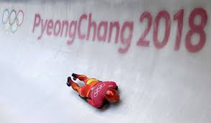
Step One: What is a persuasive essay?
Reading Like a Writer: Remember that when we close read in this context, that we are looking for writers craft.
Mentor Text: Rick Reilly - "Keep Skeleton in the Closet“ (Rick Reilly is a famous sports writer known for infusing humour into this persuasive writing pieces. I thought it would be fun for you to see how a unique writer such as Reilly, writes his persuasive pieces. A link to the article is provided on this slide and the file is on my Teacher Page and Teams Site)
Your Task: Notice how the author uses the following traits of writing:
1. voice
2. conventional artistry (using punctuation, spelling, etc. in a creative way for effect)
3. creative sentence structure (mixing up sentence lengths for effect)
4. argument (Where do you notice the author's opinion?)
If you would like, you can write down what you noticed on the following slide.
https://vault.si.com/vault/2006/01/23/keep-skeleton-in-the-closet

Slide 8
Reading Like a Writer:
What did you notice the author, Rick Reilly, doing in his writing?
voice:
conventional artistry (using punctuation, spelling, etc. in a creative way for effect):
creative sentence structure (mixing up sentence lengths for effect):
argument (Where do you notice the author's opinion?):

Slide 9
Closing thinking question: How is this persuasive piece different than those you have read and written in the past?

Slide 10
Important Take Away from Rick Reilly Article
Let your personality come through in your writing.
Don’t be afraid to use humour and sarcasm if it suits the topic.
Be creative with your sentence structure and use of conventions.
All of these are persuasive techniques that Rick Reilly uses to convince his audience to agree with his point of view!

Slide 11
To prove my point, check out what Rick Reilly’s essay would look like without voice and creativity…

Slide 12
SKELETON SHOULD NOT BE A WINTER OLYMPIC SPORT
BY LITERALLY ANYONE
Not every activity can be considered a sport, much less a sport deserving a place in the Winter Olympics. This is especially true of skeleton.
In skeleton, people ride a small sled down a frozen track while lying face down and head-first. Although it receives the same attention as any other sport at the Winter Olympics, it does not involve the same level of strategy, skill, or artistry required by other sports.
Skeleton’s competitors do not need to train as much as those of other sports: for example, national skeleton champion Eric Bernotas only discovered the sport by chance three years prior to his 2004 win.
Not many people even compete in skeleton at any level, including beginners. U.S. Olympic skeleton spokesman Tom LaDue estimates that there are only 100 to 200 competitors in the United States.
Although it was rightly removed from the Winter Olympics in 1948, skeleton was reinstated for the Salt Lake City Games in 2002. This was for two reasons: 1) the IOC needs content to fill the 17 days that the Games last; 2) it’s a cheap sport to run, since it only requires the same venue, stands, and cameras that are already required for bobsledding.
Jim Shea Jr. (a member of the movement to reinstate skeleton at the Winter Olympics) was the best male skeleton competitor in the USA in 2002, and so was given all the privileges that come with being a star athlete: reading the athletic oath at the Opening Ceremonies in front of four billion people; holding the torch; and visiting President Bush at the White House. He himself, however, admits that he only got into skeleton on a whim, and that it hardly requires much skill or technique.
The U.S. skeleton team’s track record has not been remarkable enough to justify its inclusion in the Olympics. To date, its only newsworthy events have been: 1) the suspension of its coach, Tim Nardiello, after two female skeleton competitors accused him of sexual misconduct; 2) one of its best athletes, Noelle Pikus-Pace, breaking her leg after falling from a platform near the bobsled track; and 3) competitor Zach Lund’s positive test for a substance which can be used to mask performance enhancing drugs.
Given all of this, it is clear that skeleton should not be a Winter Olympic sport.
snoozefest

Slide 13
Comparing Writers’ Styles
So if Rick Reilly’s persuasive techniques are to use humour and sarcasm to draw the reader in, what are other writers doing? I mean, not everyone is funny. Let’s take a look at Mitch Albom, another prize-winning sports writer. He likes to get creative with his sentence structure and conventions, just like Reilly, and he likes to use his voice to persuade the audience. BUT, rather than appealing to the audience’s sense of humour, he appeals to their heartstrings, their emotions, their…sensitive sides.
Take a look…

Slide 14
“A Senseless Death in Our Age of Anger” by Mitch Albom
https://www.mitchalbom.com/a-senseless-death-in-our-age-of-anger/ (also available in document form on my Teacher Page and Teams Site)
Reading Like a Writer Look Fors (you can write in answers on the following slide):
  Voice (where does Albom appeal to emotion):
  Creative sentence structure:
  Conventional Artistry:
  What is his argument/opinion?:

Slide 15
  Voice (where does Albom appeal to emotion):
  Creative sentence structure:
  Conventional Artistry:
  What is his argument/opinion?:

Slide 16
What should your persuasive essay look like?
Now that we’ve checked out some interesting choices that professional writers are making in their work, let’s look at the specifics of what a strong grade 8 persuasive essay looks like.
Your task: Read the mentor text essay and complete the tasks on the next slide.

Slide 17
Persuasive writing: the end goal
Our goal for this unit is a persuasive essay
  A piece of writing that argues for or against a position on a given issue using supporting evidence and persuasive techniques.

Slide 18
Read “Bike Lanes“ by a former grade 8 student from DLMS. The full text can be found on my Teacher Page. Look for the following:
1. organizational strategies
2. evidence to support the student’s opinion
3. persuasive strategies
4. things you don't understand

Slide 19
Let’s take a look another one. This one is called “A Deep Dive Into the Plastic Bag Crisis”. Check it out on the next slide.
There are no tasks with this one. It is simply to give you another example of a persuasive essay.

Slide 20
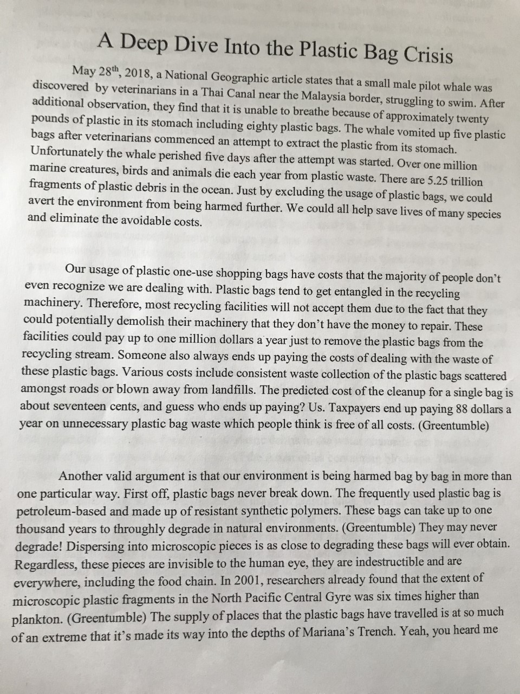
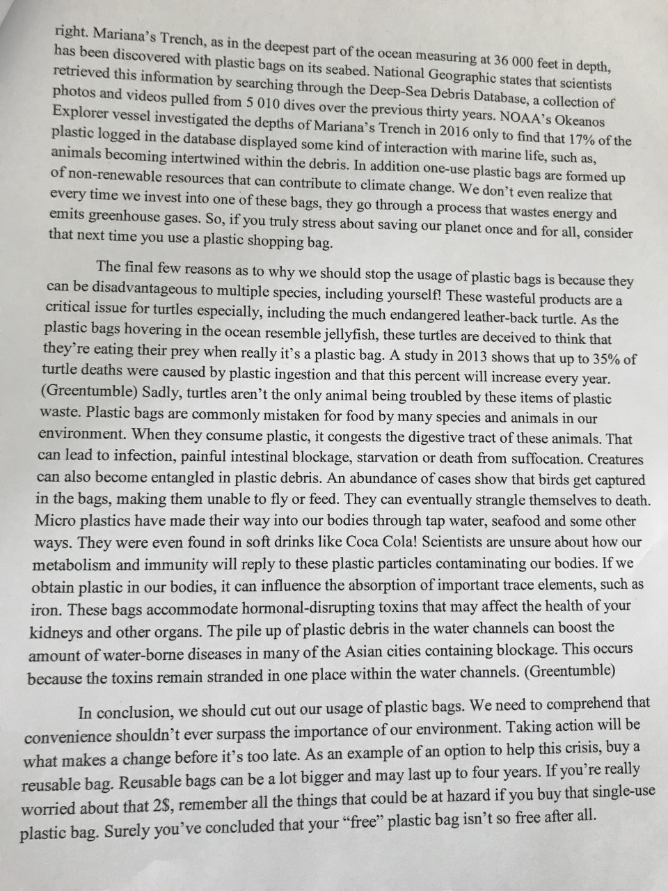

Slide 21
By looking at both of these essays you can see that there are some clear criteria that you need to follow when writing your essay:
The essays have an introduction that includes a hook and a statement of the writer’s opinion on the topic.
There are at least three supporting arguments for the writer’s opinion (each argument has its own paragraph).
The conclusion is interesting and leaves the reader thinking.
The writers have included evidence from online resources to support their opinions.

Slide 22
Persuasive writing: the process – this is the process you will be following to write your essay
Prewriting
Choosing a topic
Researching
Planning
Drafting
Revising and Editing
Publishing
Effective introductions
Writing strong paragraphs
Incorporating quotes
Paraphrasing
Transition Words
Effective conclusions
Using a revision and editing checklist
Typing the good copy

