Slide 1
Prewriting: Brainstorming a topic
Now that you know what a persuasive essay looks like, let’s start thinking about your own essay!

Slide 2
I Think We’re Ready to Choose a Topic! Perhaps some of these questions might get you thinking:
What problem needs solving?
What situation needs correcting?
What issue needs explaining?
What choice I've made/stand I've taken/personal preference needs to be understood by others?
What area of my expertise needs sharing?
What point of view needs my powers of persuasion?
Here are some topics that I’ve thought about in the past:
Homework - should we be assigning it? Is it valuable?
Are sharks as dangerous as people think? What causes people to think that sharks are dangerous?
How does the media influence our behaviour?
Should school start at a later time to accommodate teen sleep habits?
Is our government doing enough to stop the spread of Covid-19?
How can digital-free times help bring our families together?
How can the city council make Miramichi a better place for teenagers?
Should fighting be allowed in professional hockey? Should checking be taught in minor hockey?
How does learning an instrument positively affect brain development?

Slide 3
Your task: brainstorm topics for your persuasive essay
Use the questions on the previous slide to help you.
You may do a digital or hard copy brainstorm in your student booklet or on the next slide.
Remember, a brainstorm can be a web, a list, a word splash – whatever works for you.

Slide 4
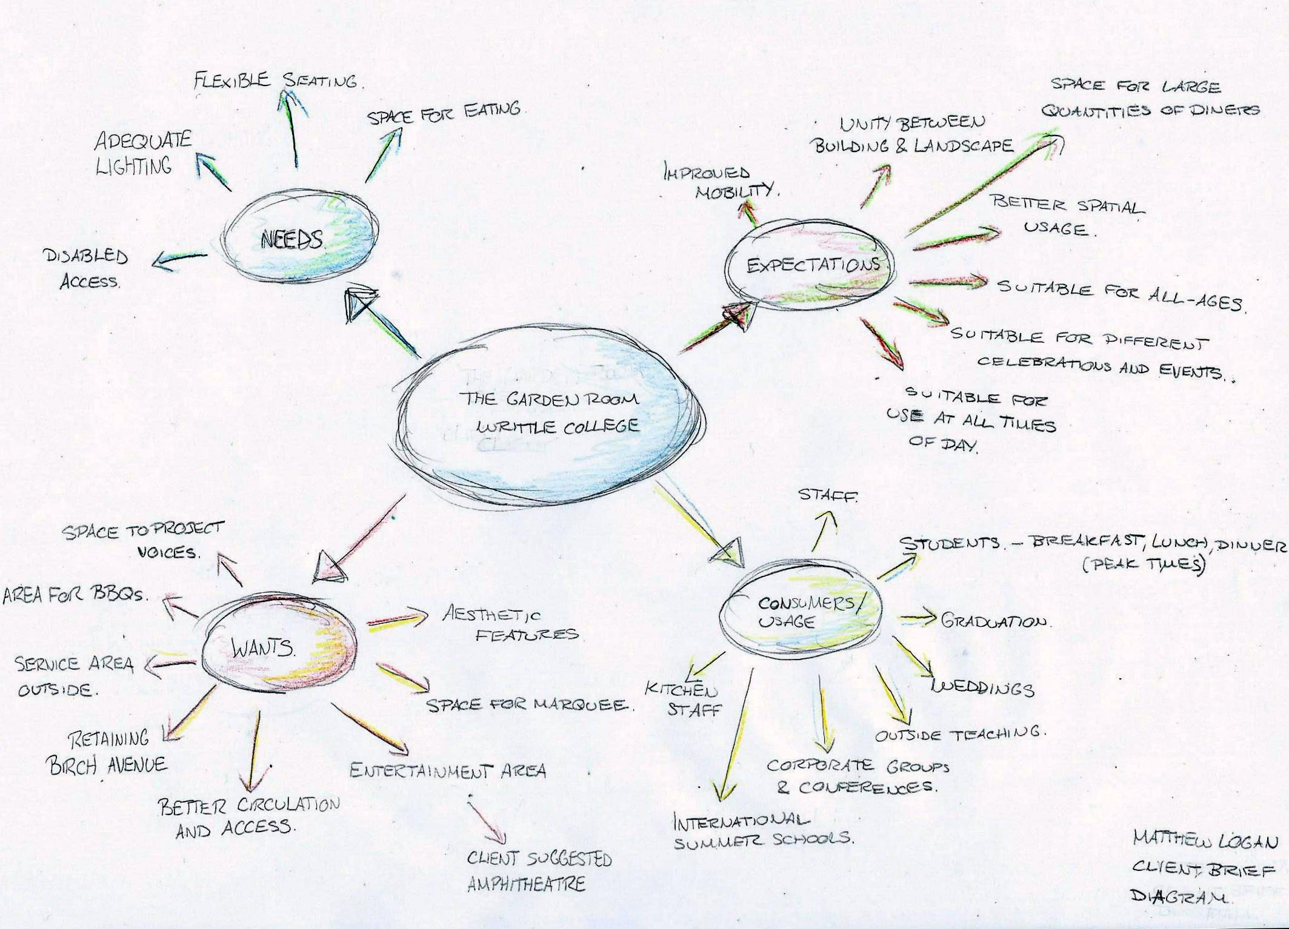
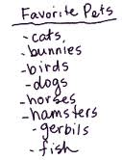
Brainstorming a topic

Slide 5
My brainstorm
My topic:

Slide 6
STOP
Now would actually be a great time to email me and let me know what topic you have chosen. I can let you know if you’re on the right track before you begin putting time into your research.
krista.cabel@nbed.nb.ca

Slide 7
Prewriting: Researching Your Topic
Once you’ve chosen your topic, you are ready to begin researching your topic online.

Slide 8
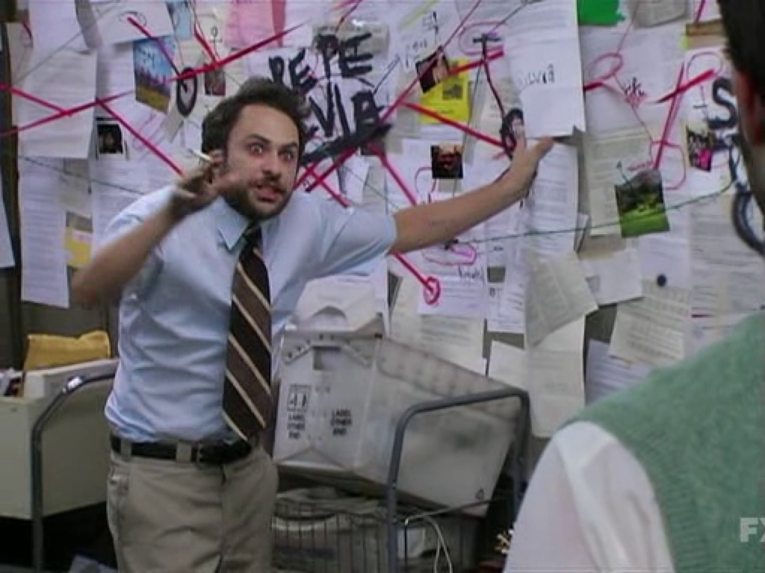
Research
Connecting the dots to make a knock-down argument

Slide 9
Research
When you look on the Internet for information, you must choose only appropriate resources. When you use books, half of the work is done for you because the author first has to go through a publisher. This is not the case with the Internet, so you need to be more careful when researching.
Do not use information from blogs, chat rooms, or personal websites
try to find the websites of associations and organizations involved with your topic. Ex: if ​your topic is the Olympics, find the official site of the Olympics
look for the use of formal language -- if language is too informal, it is probably not a reliable ​source
if you find an article online, make sure that the author has used quotations, evidence, and ​sources
articles from notable newspapers or news stations are also good sources of information ​(ex: Globe and Mail, cbc.ca, Washington Post, New York Times, etc.)
start with a specific keyword search at google.ca -- use quotation marks! Ex: "violence in hockey"

Slide 10
Your Friends Good sources!

Slide 11
Not Your Friends

Slide 12
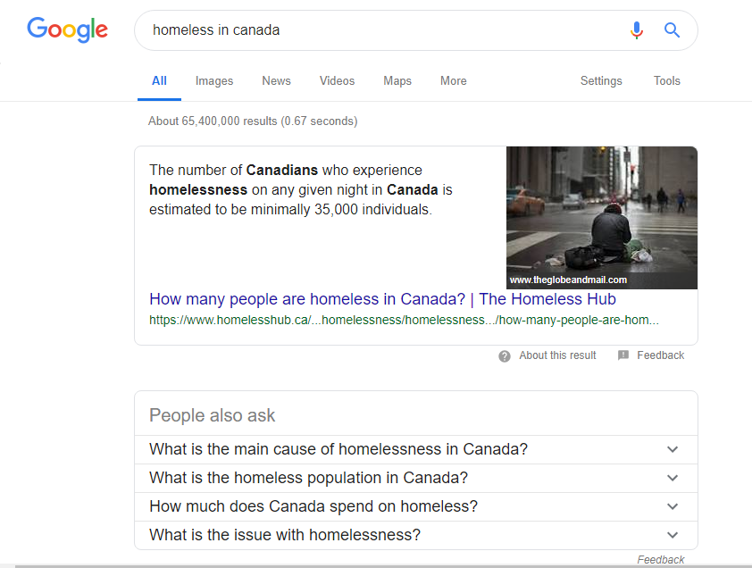
How to search for info.
Let’s see how Mr. Loggie started his internet search for his essay last year.

Slide 13
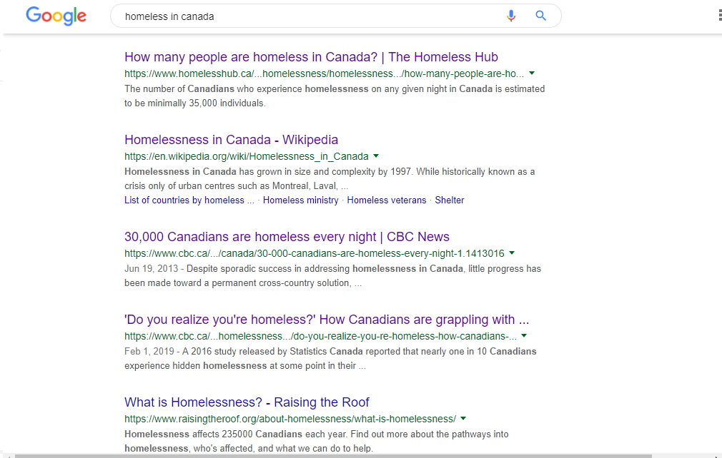

Slide 14
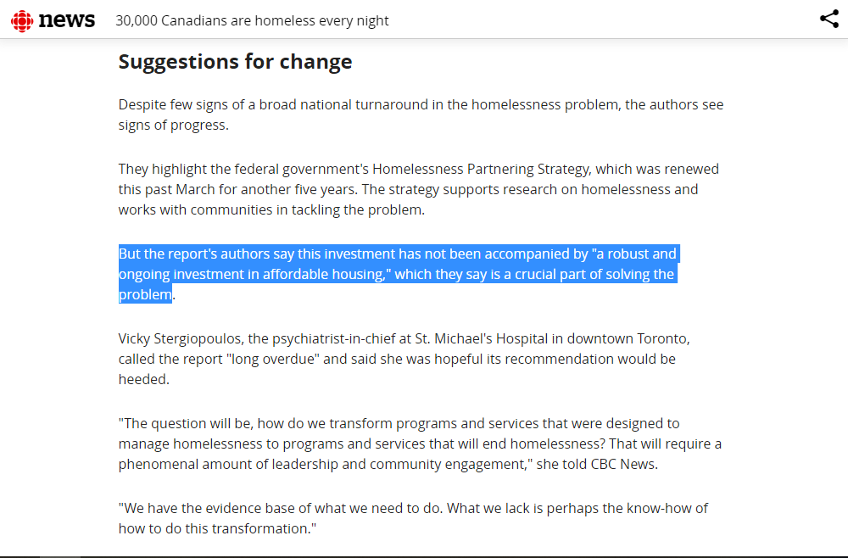
Legit Site!
This article is a great source! It is from CBC News, which is a reputable news source. Also, the author has used quotes from experts to support.

Slide 15
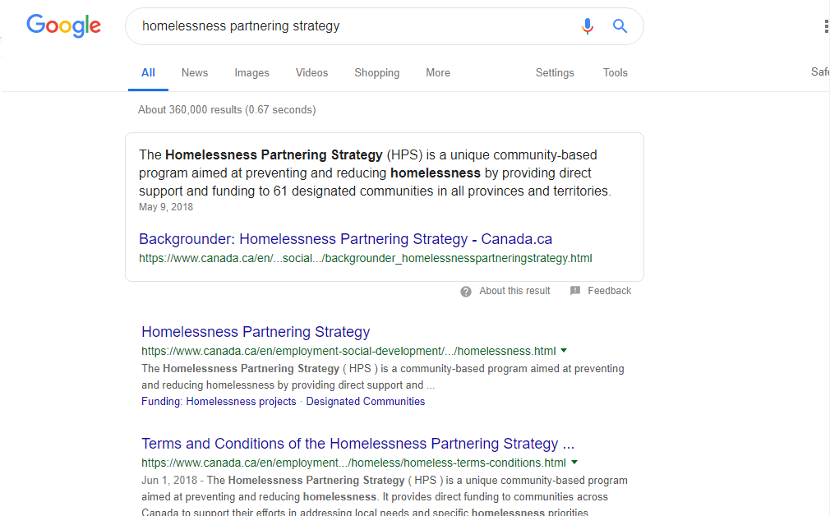
Another Legit Source!
This is from Canada.ca, the Government of Canada’s official website. We know that this is a legitimate source of information.

Slide 16
So I have at least three sources of information on my topic. What do I do now?
When I first compile my research, I like to print off the articles and highlight them – like we would do for a close reading in our Article of the Week.
Sometimes we’re not able to print them off, so we can take notes from the article. When you take notes, you should write down:
Important information that supports your argument – information that relates to the main idea and supporting details of the article.
Possible quotes for your essay. Sometimes, what an author says will really stick out to you. In that case, I write it down word for word because I might want to use that as a quote in my essay.
I have provided a note-taking sheet on my Teacher Page as well as in the workbook. You may use this or create some extra slides here to keep notes on your research.

