Slide 1

Let’s have fun with words!
A little poetry to end our year

Slide 2
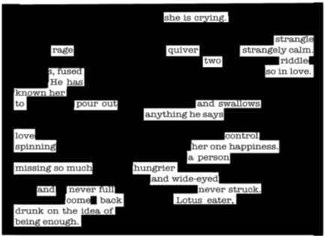
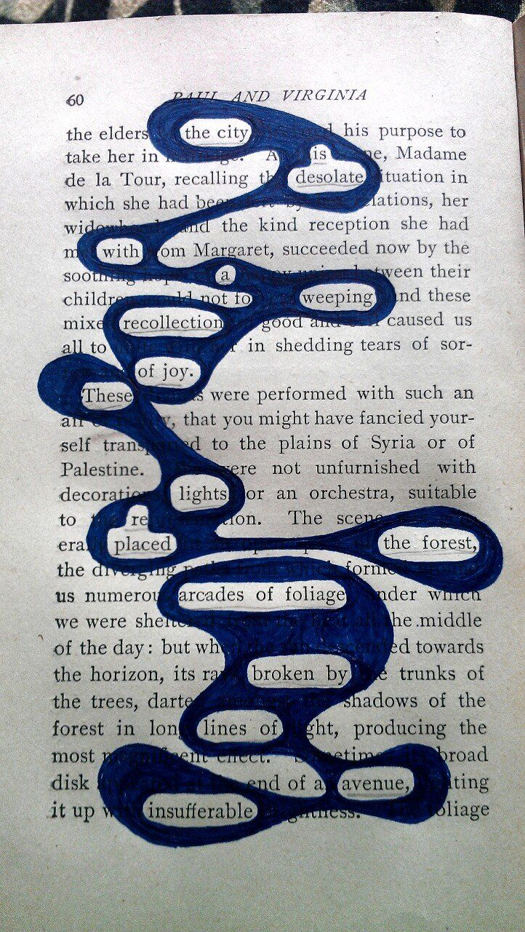
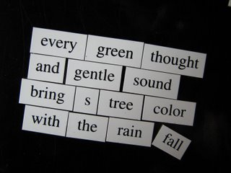
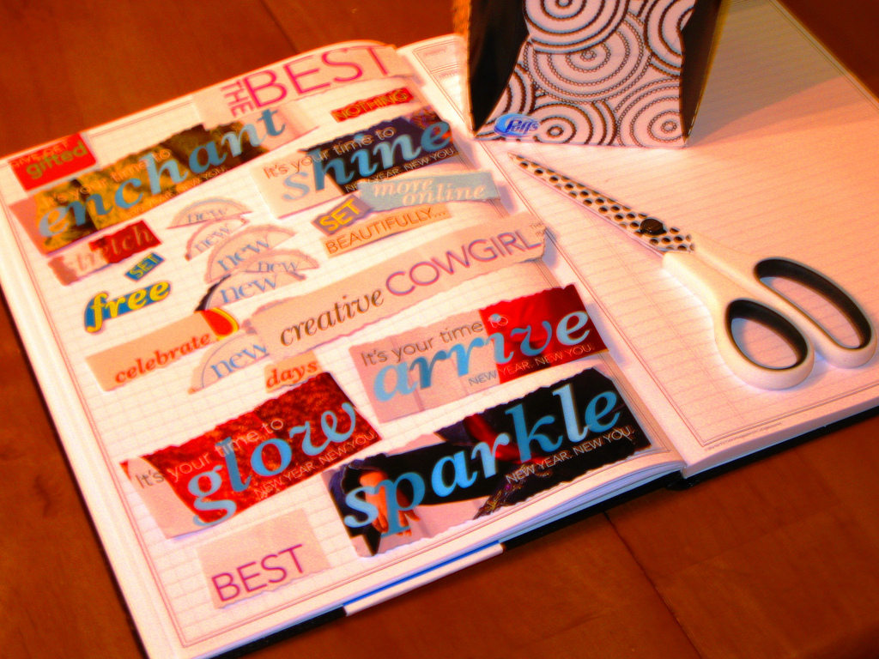
Found Poetry
FOUND POETRY IS WHEN WE BORROW WORDS FROM OUR ENVIRONMENT TO CREATE ORIGINAL POETRY. THESE WORDS CAN COME FROM NOVELS WE’RE READING, WORD ART FROM MAGAZINES, WORDS FROM SIGNS AND BILLBOARDS, WORDS FROM SONGS, AMONG OTHERs.
Found poetry is a great way to start a poetry unit as it is a fun way to play with words. We are going to try this with online magnetic poetry. Follow the link below to create your own magnetic poem. Take a screenshot of your poem and email it to me or insert it as a picture on a new slide. If you would prefer to do a more hands on poem like the examples on this slide, please do so! You can take a picture and send it to me.
Have fun!
Online Magnetic Poetry

Slide 3
My Found Poem (Insert picture below)
If you are a lover of writing poetry, take this opportunity to experiment with writing some original poetry. Send me examples of your work!

Slide 4
Poetry Reading Response
Choose a poem or song and create a reading response. Feel free to create your own response (writing or drawing) or use one of the following prompts to help you:
Why do you like the poem or song? How does it make you feel?
What do you visualize when reading/listening to the poem/song? Draw or write about it.
What does the poem/song remind you of?
*You may complete this on the next slide or in your writers notebook.
*A great website for searching for poems is poetry.org

Slide 5
My Found Poem (Insert picture below)

Slide 6
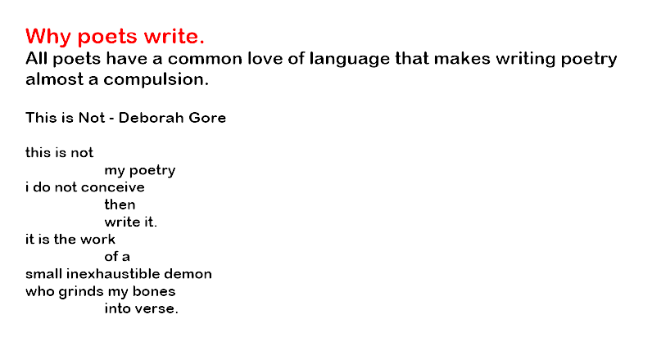
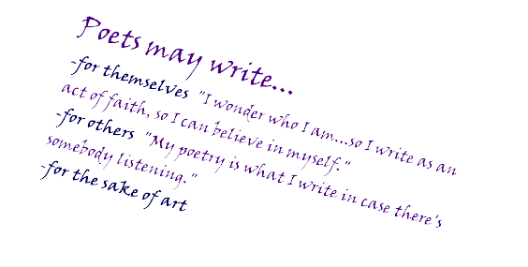
Being a Critical Reader

Slide 7
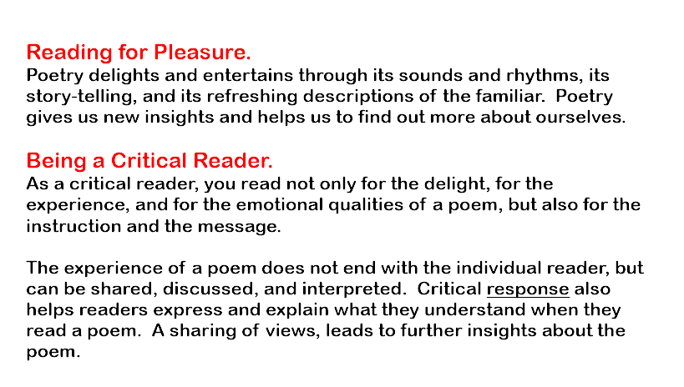
Being a Critical Reader

Slide 8
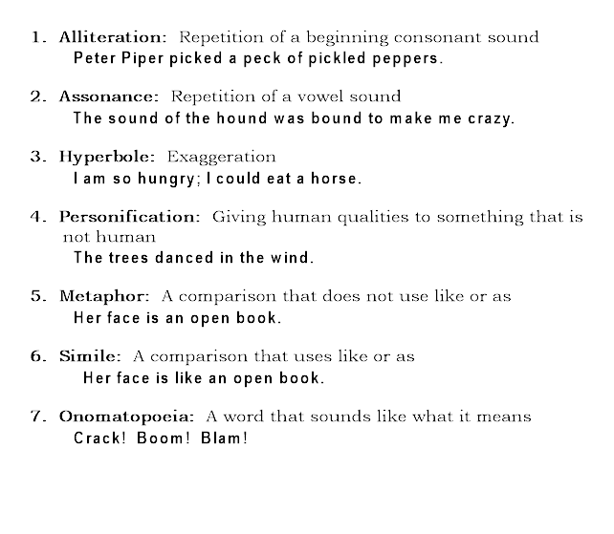
Figurative Language
One of the most important skills we use when doing a critical reading of a poem, is noticing how the poet uses figurative language to enhance sound and meaning.
Check out the list of common types of figurative language used in poetry.

Slide 9
Practice Identifying Figurative Language
“The Sound of Silence” – Simon and Garfunkel
Hello darkness, my old friend,
I've come to talk with you again,
Because a vision softly creeping,
Left its seeds while I was sleeping,
And the vision that was planted in my brain
Still remains
Within the sound of silence.
In restless dreams I walked alone
Narrow streets of cobblestone,
'Neath the halo of a street lamp,
I turned my collar to the cold and damp
When my eyes were stabbed by the flash of
a neon light
That split the night
And touched the sound of silence.
And in the naked light I saw
Ten thousand people, maybe more.
People talking without speaking,
People hearing without listening,
People writing songs that voices never share
And no one dared
Disturb the sound of silence.
"Fools" said I, “You do not know
Silence like a cancer grows.
Hear my words that I might teach you,
Take my arms that I might reach you."
But my words like silent raindrops fell,
And echoed
In the wells of silence
And the people bowed and prayed
To the neon god they made.
And the sign flashed out its warning,
In the words that it was forming.
And the signs said, The words of the prophets
are written on the subway walls
And tenement halls.
And whispered in the sounds of silence.
The song “Sound of Silence” by Simon and Garfunkel is a great example of a poetic text to use for identifying figurative language because it includes all the different types! See if you can find one example of each of the following in this song:
Alliteration
Assonance
Hyperbole
Personification
Simile
Metaphor
Onomatopoeia
*Highlight the example and type the name of the type (ex: alliteration).
If you would like to hear the song, click here: Sound of Silence

Slide 10
Poetry or Song Analysis
Great job on identifying figurative language in “Sound of Silence”. Now it’s your turn to pick your own poem or song – you will use this poem/song to complete a critical reading. This can be completed on the following slides or on the worksheet provided on my Teacher Page.
I am also including a mentor text on the next slide to help you.
*If you would like to challenge yourself more with this activity, I am also including an enriched poetry analysis sheet.

Slide 11
Student poem used for example
Dandelion Wars
By Liam Anderson
I gaze upon the army:
hundreds of yellow heads.
Although they stand just three inches tall,
I know they are deadly.
I draw my sword from my sheath.
I, King Lord Sir Mr. Al Bob, take no prisoners.
As the head pops off the first man,
I smile a mean smile, then glare at my next target.
After a wild battle scream,
head number two sails through the air.
I'm on a roll.
I throw my sword high in the air to show off my skills,
only to have it land on my foot.
I lie on the lawn, pretending to be dead.
"They'll never guess this," I whisper with a grin.
Then I jump up, grab my sword,
and put on my best pose.
I can tell they're shaking in their shoes.
I begin to hum my war song,
emphasizing a note whenever a head flies.
I, King Lord Sir Mr. Al Bob, take no prisoners.
Finally, the battle is over.
I give the falling bodies my signature look--
frightening frown, eyes narrowed, ears back--
accompanied by a short grunt as I exit on my steed.
I, King Lord Sir Mr. Al Bob, take no prisoners.
Now
I watch my little brother kill dandelions
with Mother's broom,
hum Wishbone's theme song,
and ride away on a tree branch.
I shake my head and think,
"What the heck are you doing?"
But then I remember the dandelion wars,
how I thought I was tough
when I popped off the head of a weed.
And I miss it.
So I throw on a jacket
and some shoes,
grab a broom,
and head outside to join Eoin for a taste of my childhood.
I, King Lord Sir Mr. Al Bob, still take no prisoners.
“Dandelion Wars” by Liam Anderson
On the next slide you will see my analysis of this poem. Use it as a mentor text as you complete your own.

Slide 12
Poetry Reflection Sheet
Name of Song/Poem: “The Dandelion Wars”
Artist/Writer: Liam Anderson
What was your initial emotional response to the poem/song? Which parts of the poem/song elicited that response?
This poem makes me nostalgic for childhood. It makes me think about the importance of holding on to our inner child. Beautiful visual details such as the “hundreds of yellow heads” combined with sound details like the “wild battle scream” help to create a vivid picture in my mind of the boy’s imaginary world.
Translate the poem in your own words. What is the poem about?
The narrator in the poem reminisces about when he was a young boy and would pretend to be a King at war with dandelion soldiers, which he would defeat by decapitating them with his “sword”. He is now older and watches his brother playing a similar game and he wonders why his brother is acting so silly. He remembers being a kid again and sees the fun part of him he left behind – he then goes out to play with his brother and reconnects with his inner child.
What do you think is the theme of the poem/song? Write this in paragraph form, using a quote to support your response.
“Dandelion Wars” refers to a childhood game that the speaker used to play, but on a deeper level, it can refer to the internal war that young adults battle when losing childhood innocence. The theme is coming of age and when the speaker embraces his childhood innocence at the end of the poem, we are reminded that we can always be young at heart. The structure of the poem is free verse, and while most stanzas are similar in length, one stands out – “And I miss it”. This line is given a stanza all on its own, which highlights the importance of this line. Indeed, the speaker misses being a child, which is a central theme in the poem.
What are three examples of poetic devices used in this poem? Explain how it influences the overall effect of the poem/song.
Poetic Device | Evidence from Text | Effect on Poem/Song
Metaphor | “I gaze upon the army: hundreds of yellow heads” | The poet uses the metaphor of an army to describe the dandelions, which paints a clearer picture of the boy’s imaginary world.
Personification | “they are deadly” and “shaking in their shoes”. | The author uses personification to give the dandelions human qualities, which puts us in the young boy’s shoes as he uses his imagination.
onomatopoeia | “grunt” | This word demonstrates the confidence that the author had when he was within his imaginary world.

Slide 13

Poetry/Song Analysis
Name of Poem/Song:
Name of Writer:
1. What was your initial emotional response to the poem/song? How did it make you feel, and why?

Slide 14

Poetry/Song Analysis cont…
2. Translate the poem in your own words. What is the poem about?

Slide 15
Poetry/Song Analysis cont…
3. What do you think is the theme of the poem/song? Write this in paragraph form, using a quote to support your response.

Slide 16
Poetry/Song Analysis cont…
4. What are three examples of poetic devices used in this poem? Explain how it influences the overall effect of the poem/song.
Figurative Language Example | Word/Phrase as Evidence | Effect of figurative language example on poem/song
1.
2.
3.

