Slide 1
Drafting: The Body
Now that you’ve finished one paragraph of the body of your essay, we are going to use this week to finish the rest of the body. For most of you, this will be two more paragraphs, but if you need to add more paragraphs, that is fine.

Slide 2
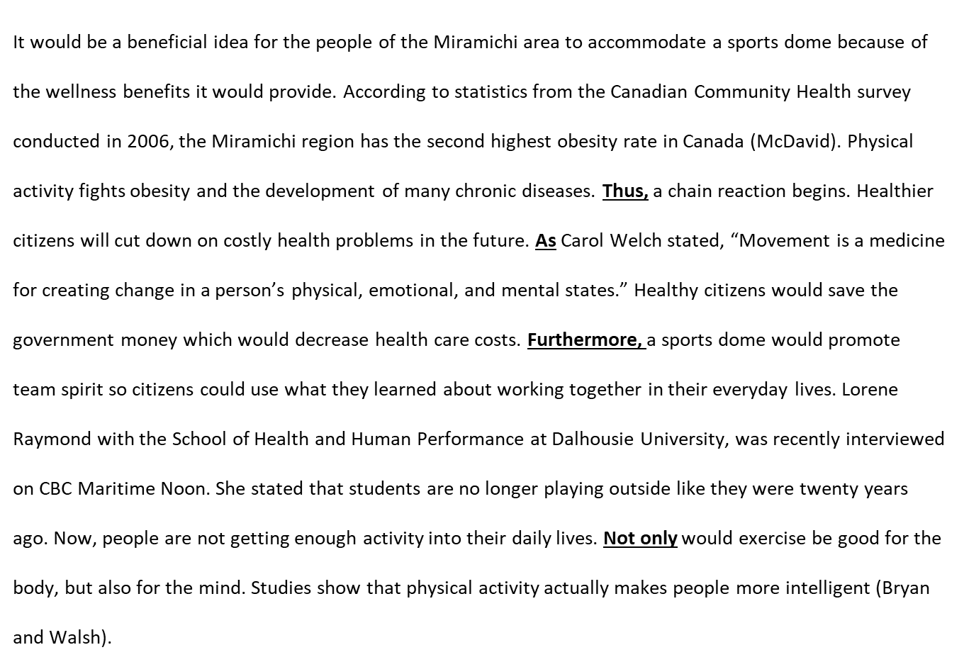
Mini-lesson: Transition Words
A persuasive essay is a perfect opportunity to use
transition words:
As a result
However
Therefore
Thus
Consequently
Although
By contrast
To conclude
In addition
Moreover
Furthermore
In particular

Slide 3
Now it’s your turn. Write your second body paragraph. Don’t forget to try paraphrasing or incorporating a quote into at least one of your body paragraphs.

Slide 4
Write your third body paragraph.

Slide 5
Wondering if you’re on the right track? Here are the grade 8 standards for persuasive writing…
 | Strong | Proficient | Acceptable | Developing | Beginning
Ideas and Content | Takes a clear position and supports it consistently with thoughtful and original reasons/ research and background information and/or examples. | Takes a clear position and supports it with relevant reasons/ research and background information and/or examples through much of the essay. | Takes a clear position and supports it with some relevant reasons and/or examples; some reasons require more detail to support. | Position is unclear; supporting details are too general or off-topic. | Position is unclear; supporting details are minimal or non-existent.
Organization | Organized in a logical manner; paragraphing is varied for creative effect and makes use of effective transitions. Creative and engaging introduction and conclusion. | Logical order and structure. Proper use of paragraphing and transitions. Inviting introduction and satisfying closure. | Is generally organized with appropriate paragraphing and adequate use of transitions between sections. Basic introduction and conclusion. | Is organized in parts of the essay; other parts are disjointed and/or lack transitions. Ineffective use of paragraph breaks. Introduction and conclusion are unclear. | Is disorganized or unfocused throughout much of the essay. Introduction and/or conclusion lack development.
Voice | Skillfully connects with the audience. Demonstrates strong conviction and commitment to the topic. Develops ideas in a unique or unusual way, revealing the writer’s perspective (persuasive strategies). | Tailors their message to the audience. Shows care and commitment to the topic. Writer behind the words comes through. Use of some persuasive strategies to create voice. | Appropriate to audience and purpose. Persuasive tone is used throughout the essay. | Tone is not appropriate to the audience and/or purpose. A lack of persuasive devices leads the writing to sound mechanical. | Little or no hint of the writer behind the words. Persuasive devices are not used.
Word Choice | Effectively includes vivid vocabulary/precise technical words, which energize the writing. | Includes interesting words and/or technical/subject-specific language to enhance meaning. | Language is functional and appropriate. Some interesting words are used to enhance meaning. | Word choice may be accurate, but there is no attempt at deliberate choice of words that enhance meaning. | Word choice has not been considered and may often be inaccurate.
Sentence Fluency | High degree of craftmanship with a striking variety of complex sentence structures and types. | Includes different kinds of sentences, with a variety of sentence lengths and beginnings to create fluidity. | Generally in control. Some variety in length and structure. | Some awkward constructions with many similar patterns and beginnings. Some run-on/fragment sentences. | Sentence structure impedes readability. Frequent run-on/fragment sentences take away from fluidity of piece.
Conventions | Uses conventions skillfully to enhance meaning and voice (conventional artistry). Strong control of standard conventions of writing, including internal punctuation, correctly spelling most words, and proper use of grammatical structures. | Strong control of standard conventions of writing, including internal punctuation, correctly spelling most words, and proper use of grammatical structures; errors are few and minor. Takes some risks with conventional artistry. | Control of most writing conventions; errors are few and minor. | Errors in grammar, spelling, and punctuation sometimes interfere with understanding. | Frequent significant errors, which impede readability.

